Slide 1

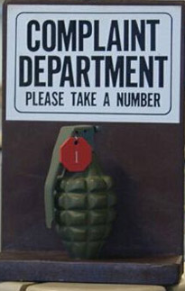
Welcome the workshop
Please anonymously write down your questions on the index card.
Thank you

Slide 2
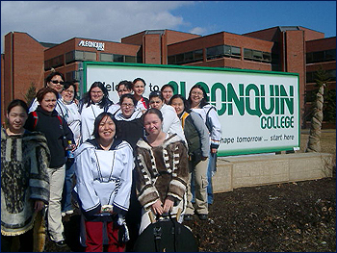
Student Satisfaction and
Complaining
Farbod Karimi

Slide 3
OUR PLAN
Welcome and Introduction 3 min
Background & My motivation 7 min
Scenario Activity 25 min
Empirical Results 10 min
Student Voices 8 min
How to manage complaints? 25 min
Dialogue & questions ☺ min
Notes:
3

Slide 4
Complaining
In one word

Slide 5
My Motivation
Informal observations
Several complaints regarding educational experiences
My business background made me more sensitive to complaining
Experimenting in class
Resistance to studying complaining

Slide 6
Purpose of the study
Explore & understand student satisfaction and complaint behavior
Examine the influence of demographic factors such as ethnicity, culture & gender.
Suggest strategies to improve student satisfaction at institutions of higher learning.

Slide 7
Types of complaining
Authentic complaints are motivated by true dissatisfaction and stem from the complainer’s genuine feelings of dissatisfaction (Kowalski, 1996).
Instrumental complaints are expressed for the purpose of changing an undesirable state of affairs (McDiarmid, 2004).

Slide 8
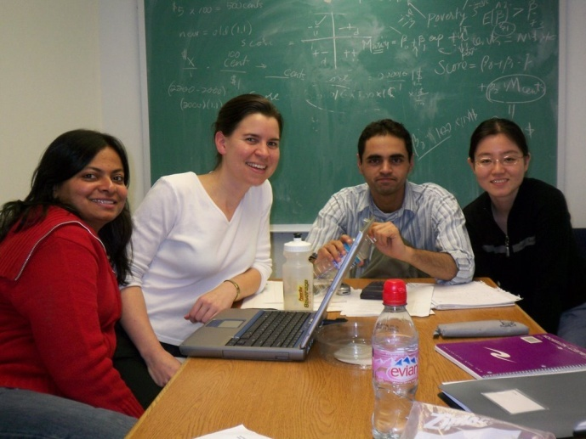
Why don’t they complain?
Low sense of empowerment
Lack of trust in persons of authority.
Cultural (e.g. fear of exposing faults)
Fear of receiving a lower grade or embarrassment

Slide 9
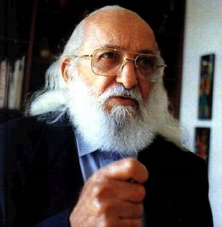

Paulo Freire
“…solutions with the people and never for them or imposed upon them”
Sonia Nieto
“Discussions about the developing strategies to solve educational problems lack the perspectives of one of the very groups they most often affect, STUDENTS”

Slide 10
Empowerment
Educationally, empowerment is defined as a dynamic process of adopting the values and enacting the practices of enlightened self-interest in order to align student and faculty goals for the class.
Alignment should not be construed to mean “ forcing the student to want what the teacher wants” or “allowing students to impose their demands on the teacher.”
(Shulman & Luechauer, 1993)
Notes:
10

Slide 11
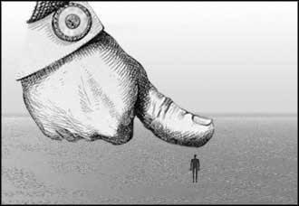
Rather, alignment occurs when students and faculty share the authority and responsibility to devise the processes and measures necessary to facilitate learning. (Shulman & Luechauer, 1993)

Slide 12


Scenario Activity
25 Minutes

Slide 13
Faculty Scenario #1
A student complains to you that he/she is not learning anything in your class.

Slide 14
Faculty Scenario #2
You are Professor. One of your students complains that you have given them an unfair grade and play favorites.

Slide 15
Faculty Scenario #3
Student is complaining to you about a service at the campus such as financial aid, registrars, etc. He/she insists that they don’t know what they are doing and asks for your help.

Slide 16
Coordinator/Specialist
Scenario # 4
I am in the Continuing Education Program and I have been taking courses for the past six years. One of my biggest frustrations is that more often than not, my teachers have not been set up with blackboard. It has happened that a number of times the teacher doesn't get access to Blackboard until the middle to end of the semester. Blackboard is a very useful tool and I really appreciate when we are able to use it. I wish the instructors would be provided access and training to manage blackboard before a class begins, and as I understand that may not always be possible, I would like them to be set up within the first two weeks of class. It seems to me that this is a reasonable request.

Slide 17
Coordinator/Success Specialist Scenarios #5
A group of students have signed a petition and come to you saying that they would like this professor to be fired yesterday.

Slide 18
Faculty Scenario #6
A student complains about another professor who is your colleague. The student says that you are a much better professor and that the other professor is unorganized, uncaring, racist, and sarcastic.

Slide 19

Dissatisfied students...
Tell Classmates
Tell Friends & Family
Complain to other Professors
Complain to Supervisor
Complain to the Professor
Drop Out of College
Drop the Course

Slide 20
A college administrator says…
“In fact, many complaints from students—regarding grading standards, rigor, fairness, etc.—are baseless and deserve little more than a few moments of quasi-sympathetic head-nodding on your part. The last thing you want to do is start an inquisition every time a student drops by with some petty gripe.”
(http://chronicle.com/jobs/news/2007/10/2007101701c.htm)

Slide 21
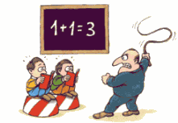
Consequences of ignoring complaints
Attack on professor is linked to grade
  UMass student charged in knifing
When Student-Adviser Tensions Erupt, the Results Can Be Fatal

Slide 22
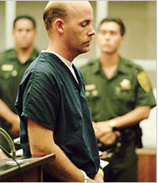
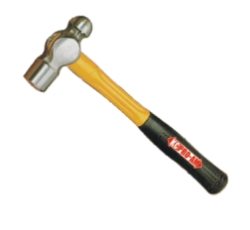
Theodore Streleski Case
Graduate student at Stanford
Murdered his faculty advisor
With a Hammer
WHY?
He felt the murder was justifiable homicide because the advisor had withheld departmental awards.
Demeaned in front of his peers.

Slide 23


Now let us hear
from our students

Slide 24
Listening
“I talked to the dean but I feel like sometimes you’re not really listened to. I understand maybe they get a lot of complaints. I get that. I get that kids don’t want to do their homework or whatever. They feel like they’re getting too much work or whatever. But sometimes there are legitimate complaints.”

Slide 25
About complaining…
“I think the problem is not enough people complain. We all talk about it. Everyone’s like, ‘Yeah. [That teacher’s] crazy. How is she today?’ It’s not like no one knows. But no one—actually, one chick did complain. And she made it through the semester but, again, [the teacher’s] still the same. It’s just one of those things where I’m like, ‘Well do I want to waste my breath?’ I feel like I’m beating a dead horse. Other than that, my educational experience is overall pretty good.”

Slide 26
About management…
“We’re not blind. We see what goes on. It’s just a matter of would you say something. And that’s why right now I feel that after I get into a position where my personal life is calmed down a little bit, I think I do need to write a letter to [school administrators] and say, ‘Hey, look. I think this is shady. I think that our dollars are ill-placed, ill-spent. Because our bathrooms are dirty but our dean’s wearing an Armani suit. You do the math.’”

Slide 27
About caring…
“Lately I’ve experienced disorganization in my school because they’re changing. At times, doesn’t feel like they’ve got it together. But as long as the teachers care about their students and their educations, which they do at my school, I’m cool with that.”

Slide 28
Empowerment…
“I felt empowered because the teacher agreed with me. And so I felt like I’m not the only one who is seeing this. I am tired of seeing teachers playing favorites. How come no one is monitoring them. I’m not the only one who feels like this isn’t right.”

Slide 29
Why they didn’t complain…
“I think they’re scared to just go ahead and speak to somebody. If I had a problem, I would probably go to somebody I know. But now it seems like even the people I know are not there no more. I came in and [staff] she just left on me. I come in one day and she’s not even there. It’s things like that, that you rely on, they’re not there no more. And then you’ve got all these new faces. So, and then, of course, if I have a problem, I’m not going to go to a new face, right? Because I don’t trust them. How you going to go and talk to somebody that’s a complete stranger?”

Slide 30
Gender…
“We have this ego, you know. Most men—young adults—have this ego about letting their pride get in the way. They don’t really want to show weakness, or they don’t really want to address something that they feel. They just think about it, keep it to themselves, and hold a grudge or something. If I show any kind of weakness, or complaints about it, then it’s showing that I’m not a real man about it.”

Slide 31
The influence of family…
“My dad stays quiet. He’s just like, ‘Why are you complaining? Why are you wasting your time?’ But my mom, the littlest thing. Like if I gave somebody five dollars and the item cost two dollars and they gave me two dollars back instead of three, she’s gonna go back for that extra dollar no matter how far we are. She’s gonna go back. She’s like, ‘No, that’s a dollar.’ And I’ll be like, ‘You know what? It’s gonna cost me five dollars just to drive back just to get that dollar back. It’s not worth it.’ She’s like, ‘No, I want that dollar.’ And she’ll make me go back.”

Slide 32
Interesting last comment
“One thing I’ve been telling a lot of people, is that the best thing I’ve learned from [this school] is patience.”

Slide 33


So What can I
do about it?
Try asking your students the following 3 questions on Day 1.

Slide 34
State at least 3 complaints which you had about your past instructors at high school, college or university?
Listening to their complaints is one way to find out what is in the learners head.
Students complain of lack of enforcement
Examples:
“My teacher rarely used the textbook”
“He talked for 2 hours straight”
“She did not care or respect us”

Slide 35
List 2 rules which you would like all of us to follow in our classroom.
Establishing communication
Creating trust and empowerment
Examples:
“No taking off your shoes in class”
“No eating smelly foods in classroom”
“Be ready and on time for class”

Slide 36
Please list additional information about you which you believe would help me better facilitate your learning. The more you tell me, the easier I can work with you to help you through this course. Thank you
Very useful for building long lasting relationships
“I have tics caused by Tourette syndrome”
“Please don’t ask me questions during class, I will raise my hand when I feel like it”

Slide 37

How to manage?
Your institution Policy/directive
Try not to take complaints personally
Do not ask them to come up with solutions
  Collective and shared solutions
Empathic listening http://www.youtube.com/watch?v=Ak4LZlw99ao
“Keepin it real”
Last resort

Slide 38
This is a fantastic forum and I hope a lot of good ideas get brought up, but... we want to know what is happening, what ideas are being looked at, who is looking at these ideas, what is being put in place.
Its nice to be heard, and who better to know what the
students want than the students.
Create an online forum where we can see what changes
are being made, a timeline, what exactly is happening!
I have noticed some of the other suggestions and
problems being brought up in the forum are not problems, just no one knows there is a solution for them! Tell us what is happening, and make it simple to access!

Slide 39
A complainer is carrying around a 100-pound rock, looking for some place to unload it. If you won’t take it, they’ll chip off little pieces and hand over some to everyone they meet…People with complaints always tell someone about it. They have to or they’ll explode.
Cottle(1990, p.250, from Bennett)
Thank you for complaining

