Slide 1

Welcome
Association of Canadian Community Colleges ECE Affinity Forum 2011

Slide 2
Strengthening Recruitment and Retention in the Sector
Joanne Morris, Cindy Page, Cheryl Heywood
CCHRSC: a brief overview
Mutually beneficial roles of the ECE and the Administrator
Using Human Resource Tools in the Preparation of ECEs and Administrators
4. Future steps: Discussing the role of colleges in the education of Family Home Child Care Providers and Home Visitors.
Notes:
Introductions of presenters.
Get a sense of who is in the audience.

Slide 3
1. CCHRSC: Overview

Slide 4
RESOURCES
CCHRSC
RESEARCH
Addresses human Resources issues through:
COLLECTIVE APPROACH
STRATEGIES
Notes:
The Childcare Human Resources Sector Council is unique.
We are the hub for information and discussion about the pressing human resource issues facing child care in Canada, issues like recruitment & retention, training, labour marketinformation.
We conduct research around these issues so that collectively, as a child care community, we can develop strategies to address them, and then create resources and tools to implement those strategies. I will provide some specific examples, later in this presentation.
We are part of the sector council program.
What are sector councils
Sector councils are part of an overall federal government program. They bring together representatives from business, labour, education, and other professional groups in a forum to analyze and address sector-wide human resource issues.
There are sector councils in a wide variety of areas such as the automotive industry, mining, information technology and tourism. They are all arms-length from government and were created as permanent organizations. They represent over 50% of the economy.
There are 33 sector councils in total, including 3 social economy sector councils – CCHRSC, HR Sector Council and the Police Sector Council.
Their goal is to increase labour market participation and overall labour quality.

Slide 5
Government
Early Childhood Educators
CCHRSC
WORKS WITH:
Post-secondary
National/
Provincial Child Care & Labour Organizations
Employers / Administrators
Notes:
We work with national and provincial child care or labour organizations; child care centres, nursery and preschools, family child care providers; early childhood educators; post-secondary training institutions; employers/administrators and ECEC government stakeholders.

Slide 6

CCHRSC: Benefit to Canada
330,000 work in the sector …
helping children develop during the crucial ‘early years’ period and enabling ...
working mothers to contribute $83 Billion to the economy
Notes:
The work of the CCHRSC is important in a sector that has a tremendous economic impact.
There are approximately 330,000 people in Canada working in the broader child care sector. Of those, more than 170,340 are early childhood educators and assistants.
Broader sector includes: 69,785 babysitters, nannies, & parent helpers, 49,600 teaching assistants working with children under 12, and 32,700 kindergarten teachers about 1/8 of all elementary and kindergarten teachers.
These professionals make it possible for parents to work outside the home. Mothers who currently work outside the home contribute $83 billion annually to our economy. Certainly, making child care available to more families would improve Canada’s international competitiveness by enabling more of our best people to work.
Quite apart from the dollars and cents, many studies show that the first five years of a child’s life are critical to their lifelong development, which underlines the importance of positive early learning experiences.

Slide 7
2. Mutually Beneficial Roles of the
ECE and the Administrator
What we have learned from the research
Resources to examine these roles
Recruitment and Retention
Joanne Morris joanne.morris@cna.nl.ca

Slide 8
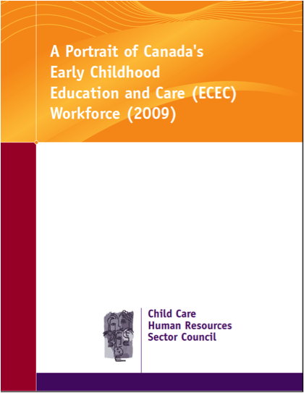
Research – What have we learned about our sector?
ECEC workforce is growing
  ECEs and assistants increased by 24.9% between 2001 and 2006
  9.5% growth in numbers of kindergarten teachers
  23.1% more teaching assistants
  24.8% decrease in babysitters, nannies & parent helpers
  Despite growth, there is an annual workforce shortage of 5,000
Notes:
ECE and assistants have increased by 24.9% 2001 to 2006 (census data) and projected to have increased considerable again especially in provinces that have introduced 4 year old kindergarten.
Unemployment rate of this group is low – 4% compared to 6.6% in all occupations
So even with the growth, there has been a steadily increasing shortage of ECEs and assistants, by 2007 this reached around 5,000. Largest shortages in Que. and Ont. But significant across the country

Slide 9

ECEs and Assistants as the Focus
Includes those who work in child care centres and family child care homes
  90,185 in centres
  47,665 in family home child care
  96% are female
  Largest group are 20 -34 years in age
  45 years and older rose 10.3%
Notes:
In 2004 Labour Market Update 98% were female.
20 – 34 years of age biggest group but 6.4% drop in those under 25 years old.
This may indicate that fewer people are choosing to go into ECE.
45 years old and older – 10.3% growth compared to 9% in all occupations.

Slide 10

Post Secondary Education
67% of ECEs and Assistants have PSE
40% possess a degree that is not child care or education
More than half of those with ECE diplomas and degrees work outside the sector
42% of students do not plan to work in the sector in 5 years time.
Notes:
The good news is: 67% of ECEs and assistants have a post-secondary credential
Compared to 58% of the total workforce in Canada
The bad news is 40% have education that is not child care or education and more than half with child-related education work outside the sector. (Stats Can.) (AIT implications for future increase in this – need national certification)
Recruitment has not been a problem but there is a serious problem with retention.
From the Training Strategy project we learned that 42% of students did not plan to be working in ECEC in 5 years time.
These factors greatly impact retention. Must find ways to stem the loss of qualified ECEs and assistants.
There is a serious growing trend across provinces of hiring of unqualified or “other” qualified which further increases turnover, keeps wages low, discourages further education, therefore undermines the ability to achieve a qualified workforce. A focus on quantity undermines quality.
This also increases the pressure on the administrator who is constantly trying to hire new staff, do orientation, repair parent-staff relationships, and think of measures to retain them.

Slide 11
Issues
Serious shortage of qualified staff across Canada across the sector
Retention issues resulting in high turnover
Most administrators have not received education in HR management skills. Improved HR management leads to reduced turnover
Although higher wages contribute to retention, job satisfaction such as working conditions, respect and recognition, and higher degree of flexibility matter even more in women-dominated professions.
Notes:
As we learned from the demographics of the sector, employment levels are increasing more quickly than for other occupations in general, which means that expansion demand is larger than for other occupations.
Furthermore, the turnover rate is much higher than for most other occupations which means that replacement demand is much higher. Nine of every 10 new employees are needed to replace ECEs who have left their jobs.
These 2 factors combined means that recruitment demand in the ECEC sector is much larger than for other occupations.
Changes in ON, BC & PEI – full-day kindergarten - may increase demand for ECEs by 20,000 in next 5 years, in Ontario alone
Strengthening the skills of the administrator is complementary to attracting and retaining qualified staff.

Slide 12
Role of the ECE - Issue of Recruitment
Occupational Standards for ECEs clearly describe the core responsibilities
In order to fulfill these, the required knowledge, skills and abilities are detailed
ECEs and Assistants who are educated in child care and education are specialized to work in this sector
Quality of the care and education of the children depends on a qualified workforce
Recruitment strategies should be focused on qualified individuals, therefore increased demands on post-secondary education institutions.
Notes:
This project focused on updating and building upon the previous set of “Occupational Standards for Childcare Practitioners”, initially developed by the Canadian Childcare Federation in 2003, and was undertaken with the participation and input of over 1000 early childhood educators (ECEs) and key stakeholders across Canada. OS released in spring 2010.
The initiative defined core occupation in ECEC and identified any additional or emerging issues such as: school age care, infant care and family care.
Refer to OS & Task Chart – often incorporated into post-secondary courses, govt. standards, recognition, respect.
If we had adequate numbers of well qualified ECEs – the administrator would be spending less time replacing staff.
PSIs are critical to effective recruitment strategies.

Slide 13

Recruitment Strategies by Colleges
What are the most effective recruitment strategies that your PSI has implemented?
Are there any government initiatives in your province or territory that are aimed at improving recruitment and retention?
Notes:
NL: $5,000 bursary
provincial portion of the student loan is paid down
$6,600 supplement when working in regulated CC
$1,200 bursary for distance students to attend on-site practicum at demonstration centre of the college

Slide 14

Role of Administrators
Occupational Standards for Administrators clearly defined the knowledge, skills and abilities needed to be an effective administrator
Several of our research projects found that the majority of administrators lacked specific HR management training beyond the ECE diploma
Forecast that improved HR management would decrease turnover by as much as 20%
Implementing best practices, offering
mentoring, and empowering employees
would alleviate both recruitment and
retention challenges.
Notes:
Original Sector Study: A Labour of Love – showed that there is a lack of leadership and management skills amongst those who work as administrators including licensees, supervisors, lead staff.
Reinforced in the Labour Market Update Study – the majority of administrators were ECEs who had been at the centre the longest, but had no specific HR management training.
In Understanding and Addressing Workforce Shortages the lack of HR management training was found to be a significant factor in staff turnover. It was forecast that improved human resource management would decrease turnover by as much as 20%.

Slide 15
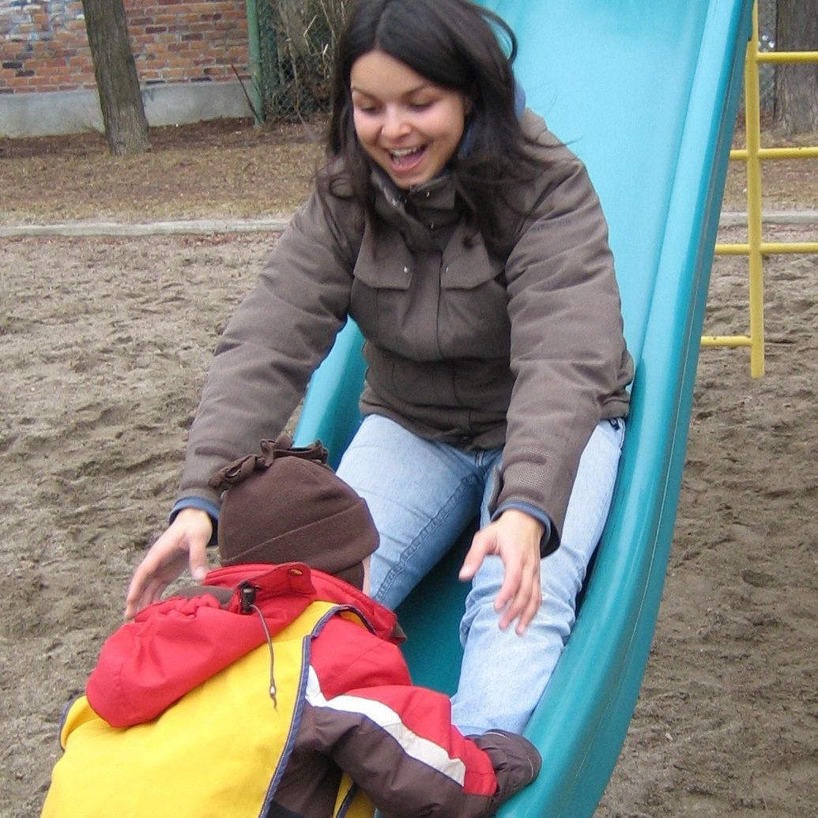
Retention Strategies
Supporting Employers project identified many best practices and resources that are required to support employers/administrators
Has lead to a current HR Tool Kit project
Few positions as supervisors – horizontal promotions provide a sense of opportunity
Reduce job stress with clearly written job descriptions descriptio staff handbooks or manuals,
performance appraisals
More autonomy in decision-making
Notes:
The ‘Supporting Employers’ project identified tools & best practices required to support employers across Canada, leading to HR Tool Kit project. Cindy will talk about this in her part of the presentation.
We were very pleased that more than 1000 employers participated in the comprehensive employer needs survey. It was the first pan-Canadian survey specifically aimed at ECEC employers.
Job stress was identified by employees that did not have clearly written job descriptions or performance appraisals and generally felt that there was a lack of clarity around job expectations.
Staff handbooks or manuals should contain all of the policies that new staff would need to know and for staff who act as mentors to new staff.
Horizontal promotions – head teacher, program coordinator, resource educators, leaders on planning, etc. This also serves to develop some infrastructure within a centre. This sharing of responsibility and decision-making encourages ECEs to feel some autonomy and some ownership for the operation of the centre.

Slide 16
Retention Strategies…
Enhancing Mutually Beneficial Roles
Encourage loyalty by showing respect for staff who need flexibility in work schedules
Recognize the ECE’s professional role:
  Time for program planning
  Space for and scheduled breaks
  Paid time for courses and professional development
  Recognition of value through salary
  increases, more responsibility in the
  operation of the centre, title designations
  with increased credentials
  Providing access to professional resources
  on site
Notes:
Respect through flexibility in work schedules enhances work/life balance for staff, avoids burn-out and lowers turnover rates.
Recognizing the ECE in her/his professional role – mutual benefits of enhancing the identity and role of the ECE through enhancement of the identity and role of the administrator.

Slide 17
Benefits for the ECE are Benefits for the Administrator. Where do we go from here?
These two roles are mutually beneficial - each need to be knowledgeable and skilled to fulfill their roles effectively.
Administrators - roles as manager, mentor and building relationships with families and community.
ECEs - ensuring a program which is based on children’s development, nurturing towards all children, and supportive of their families.
College ECE programs aim to prepare ECEs in all core areas of competency.
Phase 1 of Curriculum Development for Administrators demonstrated the need and the interest of colleges to address this gap in training.
Notes:
Phase 1 of the Curriculum Development for Administrators Project – baseline data was collected through key informant interviews and a literature review which demonstrated a demand for this type of post-diploma certificate.
In June 2010 the SC brought together 8 or 9 post-secondary institutions who were willing to work together to create 8 courses that would comprise the certificate. Unfortunately the proposal for Phase 2 was turned down for funding by HRSDC just a few weeks ago.

Slide 18
3. Using Human Resource Tools in the Preparation of ECEs and Administrators
Cindy Page
cpage@nlc.bc.ca

Slide 19
Course Design
Occupational Standards: moving from provincial to national standards
Notes:
How to Guide, p. 14-15
Build the course, using the OS as a reference point to develop learning goals, course objectives and program evaluation tools.

Slide 20
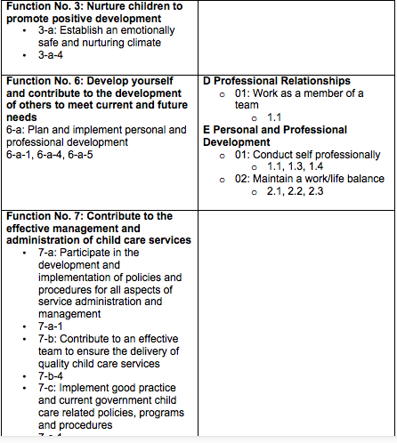
Notes:
In course outlines at NLC, we identify the provincial competencies as part of our training profile. Moving toward use of the CCHRSC OS, we are working on tables that show the relationship between provincial competencies and the national OS.
Workshop Exercise: each table will take a section to work on together, using the Task Profile chart.
Tools: each participant will get a copy of the chart and the document above – the one block filled in can serve as an example.
Note: the slide is an example of provincial competencies identified in a first year Health, Safety and Nutrition course.

Slide 21
Practicum
Competency-based assessment

Slide 22
Notes:
Document currently exists in Practicum I; similar document exists in Practicum IV and V; working on completion of Practicum II and III.
Note: the identification of national competencies does not supersede any provincial competencies or learning outcomes as identified on the course outline. At NLC, all outlines identify provincial competencies but there is some discussion about cross referencing on future outlines. Until that point, the national competencies simply point out the similarities and are an effort to show how to move from provincial to national in our existing documents.

Slide 23
Recognized Prior Learning
Using the CCHRSC ECE Occupancy Standards in Portfolio Development
Notes:
In addition to a thorough profile, students will develop a portfolio that provides evidence in each of the CCHRSC OS Tasks and Sub-Tasks
Note: this part of the presentation could take the participants in a whole different direction on RPL/PLAR. Delimit the scope of the workshop to focus on how national standards can be used in a RPL process.

Slide 25
SAFeWay
Suggested Format for Providing Evidence for Competencies
S = Statement
A = Amplify
F = Few Examples
W = Wrap Up
Institutions Branch Saskatchewan Learning (2005).
Recognizing Prior Learning: A Journey of Self Discovery Facilitators Guide to Reflection and Portfolio Development
Notes:
Suggested Format for Providing Evidence for Each Section
SAFeWay is a guide that helps learners present information or describe significant events clearly and concisely. As the name suggests, this activity is a “safe way” for people to express their thoughts and ideas. The activity helps ensure that people provide sufficient information to tell a story in a structured way. If learners cover the four components of the SAFeWay, they can feel confident that they have answered a question and outlined the key elements of an event or issue.
S = Statement Provide a description of an event, or issue as it relates to each task (use the subtask category as ideas for examples you could provide)
✓ Description of the item/event/interaction
A = Amplify Relate the statement from above to the task or subtask you have chosen ✓ What makes this event important?
✓ Why is this a good example of your learning?
F = Few examples Provide at least one example that
✓ Discuss how Knowledge/ Skills/Abilities (KSAs) were developed. ✓ What capabilities have you further developed?
W = Wrap up Tell how the information you have provided supports the statement that you opened with. This closes the summary very neatly and ties the end to the beginning and create a goal statement for continued growth and development in each section
✓ Link the closing remark to the initial statement

Slide 26
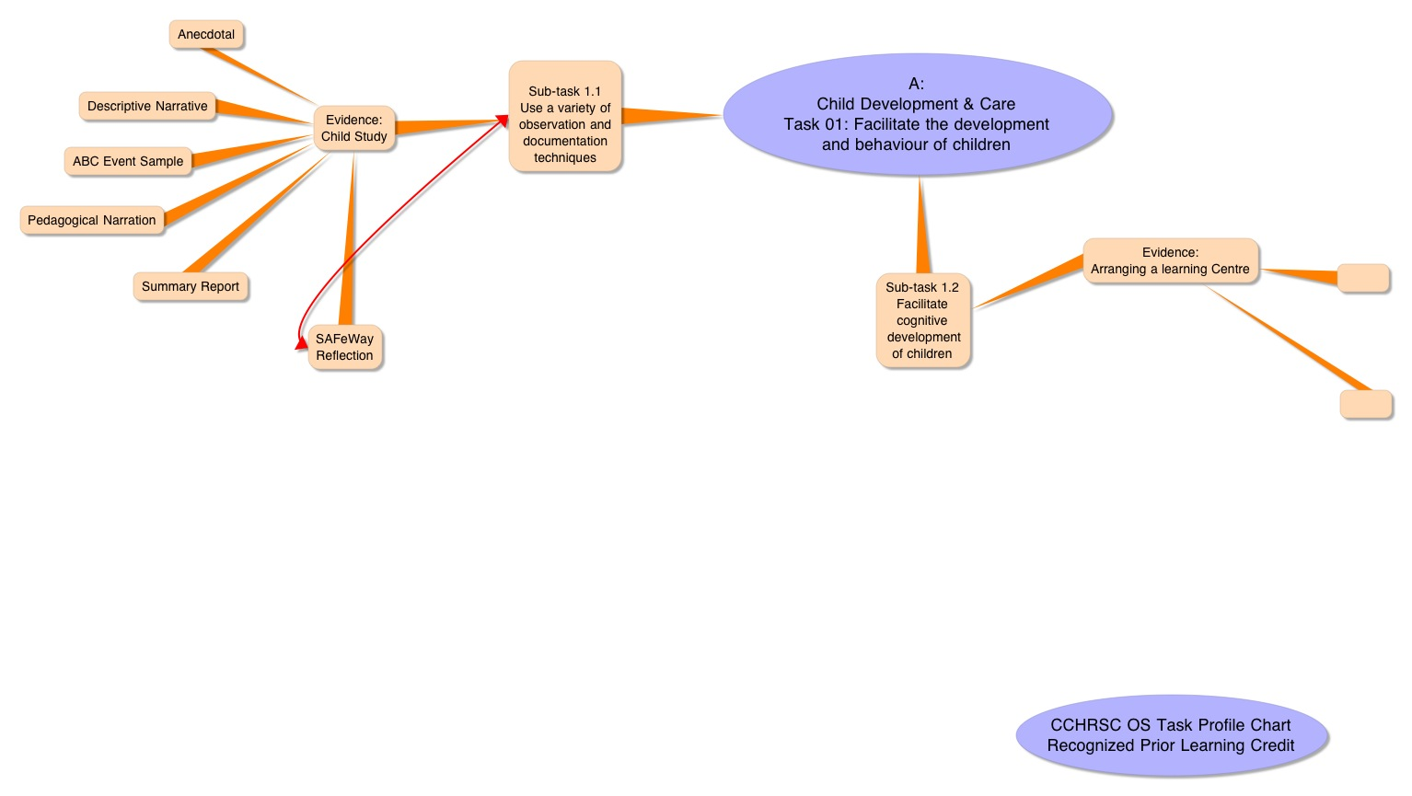
Notes:
One example of how a student could mind map a competency.

Slide 27
Tools in Action…
  First Year/ Second Year Reflect & Rate Student Practice
  In Administration course, review regularly
  Job Description Development (How To Guide)
    Create a job description
    Evaluate/revise a current job description
  Centre Evaluation
  PSI ECEC Program Assessment (How To Guide)
  Recognized Prior Learning Credit
  Practicum Demonstration

Slide 28
Tools in Action… (cont.)
  Child Care Human Resources Sector Council Website www.ccsc-cssge.ca/english
    HR Tools
      Non-Profit Management Sector www.hrvs-rhsbc.ca/hr-toolkit/home.cfm
      CCHRSC HR Tool Kit (coming soon)
    Research
      ECEC Training Programs in Canada
      Profiles (soon to be updated with videos of ECE and Administrators
      Credible ECEC Research
      People, Programs and Practices: A Training Stragegy for the ECEC Sector in Canada
Notes:
Ask for general sharing from audience…any other ideas of how the OS or CCHRSC tools could be used?

Slide 29
4. What is the role of colleges in the education of family child care providers and home visitors?
Cheryl Heywood
cheryl@communitychildcare.ca

Slide 30
Snapshot of Ontario
April 2010- Family child care as part of the continuum of child care services was transferred to the Ministry of Education
Last phase of the child care transfer-responsibility of licensing will be moved the Child Care Quality Assurance and Licensing Branch of the MOE effective January 2012
Ministry of Education expects all ECEs and providers to be implementing the ELECT curriculum framework
In Ottawa - Algonquin College and La Cité Collégiale worked with a Community Working Group to support the broad implementation of ELECT.
College instructors facilitated the community training to over 600 people across the sector.

Slide 31
Agency model in Ontario
Home visitors are typically employees of licensed home child care agencies
Agencies organize the work based on a social work model i.e. caseloads, clients
Family child care providers are affiliated with agencies. They are independent contractors and are not employees
Language continues to be a challenge for this part of the sector, i.e. home visitor or child care advisor/consultant; caregiver or provider; family child care or home child care…

Slide 32
Family Child Care A Unique and Complex Environment
“What I learned from observing children in homes after our many months of observing them in centers was that homes provide a unique physical setting where children learn in a very immediate and practical way how the world works. I also learned that the logic of homes has a different twist. The daily lesson plan for a home is how to weave all the events, both anticipated and unexpected, into a meaningful pattern. The actual pieces may seem totally random; how the cookie dough behaves compared to mud, the Eiffel tower as a backyard building project, the neighbour dropping in to complain about her lilacs not blooming, how to keep the 18 month old out of the block play, what to have for lunch. Homes are very rich, complex environments and they offer experiences that help children develop emotional intelligence, creative problem solving, and hopefully, a sense of humour about life’s unpredictability”
Sue Williamson (NAFCC President)

Slide 33
Skills Needed to be a Home Visitor
Interpersonal skills to work with adults
Training skills to deliver workshops and on-site training for providers
Skills to undertake home visits
Managing a caseload-comparable to operating a centre
Supervisory skills – coaching providers
Precise, clear , and objective recording skills
Techniques for interviewing (home openings, parent meetings)
Conflict resolution
Ethics training
Knowledge of community resources and working with community partners
Cross-cultural competency

Slide 34
Training for Child Care Providers
Agencies provide on-site training, workshops, basic training
Now training will be based on the principles of the ELECT curriculum framework
National Family Child Care training program outlines core competencies for providers
OS for ECEs and OS for Administrators also contain skills, abilities and core knowledge which can act as a guide for training
Recognizing providers’ experiential knowledge, education, and cultural backgrounds must be part of their training.

Slide 35
How can colleges support training in home child care?
How could colleges be involved in the provision of education and training to home visitors and providers?
What level of training is needed for home visitors and providers that aligns with the reality of the work?
Is the current ECE training appropriate for home child care providers? Why or why not?
How do we facilitate training so that providers will and seek further education and stay in the regulated system?
Notes:
Offer core ECE training to all who want to work with children with possibility to specialize
Specialized training particular to fcc using the FCC training program as a basis
FCC program has :1)appropriate examples for hcc providers 2) puts the emphasis on the competencies needed to work in hcc eg nutrition, communicating with parents, working alone
Educate agency staff, managers, providers in the OS for ECEs and Administrators
Train staff and providers in provincial curriculum frameworks
Work with hcc agencies for work placements in hcc and to develop on-site training that compliments the course work
Credentials, certificates

Slide 36
Human Resource Needs in Family Child Care
Managers of agencies may not have the skills to address HR needs of home visitors and providers effectively.
OS for Administrators excellent starting point
SC “How to” guide makes it possible for the development of HR tools such as job descriptions, performance evaluations
Smaller agencies may not have an HR manual: policies and practices
Professional development opportunities for home visitors
Providers – no standardized required training, no professional recognition

Slide 37
Next Steps
Bring FCC training issues to college advisory committees
Advocate for standardized and required education for providers
Recognize the gifts of knowledge that providers bring to the field in a meaningful and interactive way
Come to the HCCAO conference next year in Ottawa to continue the conversation

Slide 38


Slide 39


How to get involved
ECE Faculty PSI LinkedIn group
CCHRSC LinkedIn group
Sign up for our bulletin
/e-bulletin
CCHRSC: www.ccsc-cssge.ca/english/
ECE Affinity Group
www.accc.ca/networking

Slide 40

Thank you…

