Slide 1
Welcome
JANUARY 2013

Slide 2
Agenda
10 JANUARY 2013
Project Overview
What we set out to do
Setting Standards
The approach
The Standards, Profiles
The outcome
Using Standards
Examples on how they are used
PART
1
PART
2
Notes:
Today’s workshop is divided up into two sections:
First we will cover a quick overview of what took place as part of this project.
We will move on to a little background on Occupational Standards including the process for setting a standard and some of the important reasons this is a very specific process.
We will then move our attention back to the results of the current project and discuss some of the new features and content in this standard and the school age and infant care profiles.
And our final segment we will use some of the hands on activities that have been constructed for this workshop to demonstrate the value of these documents.

Slide 3
Child Care Human Resources Sector Council
Addresses human resource issues through:
Resources
Research
Collective Approach
Strategies
Notes:
The Child Cares Human Resources Sector Council (CCHRSC) was designed to be the hub for information and discussion about human resource issues facing child care in Canada, issues like recruitment & retention, training, labour market information.
CCHRSC conducted research around these issues so that the child care community can collectively develop strategies to address them, and then create resources and tools to implement those strategies.For the past 10 years, CCHRSC has been part of the federal sector council program.
What are sector councils
Sector councils are part of an overall federal government program. They bring together representatives from business, labour, education, and other professional groups in a forum to analyze and address sector-wide human resource issues.
There are sector councils in a wide variety of areas such as the automotive sector, mining, information technology and tourism. They are all arms-length from government and were created as permanent organizations. They represent over 50% of the economy.
Their goal is to increase labour market participation and overall labour quality.

Slide 4
Child Care Human Resources Sector Council
Works with:
EARLY CHILDHOOD EDUCATORS
GOVERNMENT
NATIONAL/ PROVINCIAL CHILD CARE AND LABOUR ORGANIZATIONS
EMPLOYERS, ADMINISTRATORS
POST-SECONDARY EDUCATION
Notes:
Over the past 10 years, CCHRSC has worked with national and provincial child care or labour organizations; child care centres, nursery and preschools, family child care providers; early childhood educators; post-secondary training institutions; employers/administrators and ECEC government stakeholders.
The organization brought together representatives from business, labour, education, and other professional groups in a forum in order to analyze and address sector-wide human resource issues.
The Council developed research, strategies, and tools to meet the needs of the child care workforce. Between (2003-2013) the Human Resources and Skills Development Canada’s (HRSDC) Sector Council Program provided funding for these activities.
As part of the work done by this organization the National Occupational Standards developed by the sector for the sector are available to be used by Child Care professionals across Canada.
It is part of a collective responsibility for organizations and businesses involved in the sector to promote best practices and use of the National Occupational Standards.

Slide 5
National Occupational Standards
and Profiles
K
KNOWLEGE
S
SKILLS
A
ATTITUDES
Notes:
National Occupational Standards describe what a person in a particular occupation needs to know and be able to do to be considered ‘capable’ in the occupation.
In general, ‘capable’ means that a person has the level of skills, knowledge and abilities required to do a job effectively, safely and properly
They are based on an extensive job analysis process that involves close consultation from a range of stakeholder – especially job incumbents and other subject matter experts.
Sector expertise and experience are the key ingredients to setting occupational standards. Extensive participation by professionals in the occupation, corroborating research, and careful validation ensure that occupational standards are precise and relevant.
By collaborating with people who work in and are affected by an occupation to produce realistic and comprehensive occupational standards. Expert job incumbents, supervisors, academics, researchers and other subject matter experts participate in a variety of activities to plan, develop, validate, ratify and ultimately help sponsor or promote the standards.

Slide 6
Let’s Talk
Please take a couple of minutes to discuss:
Have you used National Occupational Standards? If so, how?
What other resources do you consult to determine the knowledge, skills, and attitudes required of Early Childhood Educators and Child Care Administrators?
Notes:
Introduction of Participants
Have each participant introduce themselves to the group including: their name, current occupation and background, experience using NOS, and what they hope to learn from the day.
Note to facilitator:
This is a very important step to not only increase the amount of comfort the individuals in the room have with one another, but also important for you evaluate the experience and expectations in the room. You may have to change aspects of the workshop to meet expectations. You may have to ask participants to elaborate on points they make in order to help you do a better job of facilitating this workshop.

Slide 7
Knowledge, Skills and Competence
Knowledge
Skills
= performance
More accurately:
a level of performance
Includes proficiency, accuracy,
right context
“Underpinning theories and concepts, and tacit knowledge gained as a result of performing certain tasks or skills”
Competence
A demonstration of applied knowledge and abilities
Competent is used to describe a person who meets the standard.
They are superior job performers
(because they possess the knowledge, skills...)
Notes:
National Occupational Standards describe what a person in a particular occupation needs to know and be able to do to be considered ‘capable’ in the occupation.
In general, ‘capable’ means that a person has the level of skills, knowledge and abilities required to do a job effectively, safely and properly.
Demonstration of applied knowledge and abilities in a workplace setting
Consider levels of competency
Note: the occupational standard defines level and context

Slide 8
NOS or Profile Format
Occupational Domain
MAJOR SECTIONS
(Key competencies)
Embodiment of domain
RELATED TASKS
General knowledge and performance requirements
Knowledge of...
Ability to...
Statement
Statement
SUBTASKS
Explicit details of the skills
CONTEXT RATINGS
Statement
Statement
!
Notes:
Occupational standards contain several major categories which are the key competencies associated with the profession. Knowledge and performance Task statements further define each major category.
Explicit details of the tasks are defined by subtask statements.
The context of the tasks is defined by importance, frequency and time to become proficient

Slide 9
Child Care Administrator
National Occupational Standards
Contextual Information
IMPORTANCE/ CRITICALITY
FREQUENCY
TIME TO BECOME PROFICIENT
Notes:
New Features
Tasks have a new component titled “Contextual Information”. Contextual information includes the importance, frequency of performance and the amount of time it takes to become proficient or competent in a task.
Importance will be rated as:
Important: low risk to the operation if not performed correctly, e.g. minimal risk to children’s well being, minimal disruption to centre’s operations
Very important: moderate risk to the operation if not performed correctly, e.g. some risk to children’s well being, could incur fines
Extremely important: high risk to the operation if not performed correctly, e.g. risk to children’s well being, parents may withdraw children from centre
Critical: severe risk to the operation if not performed correctly, e.g. children’s lives at risk, centre could have license revoked, organization held liable, administrator could lose job
FREQUENCY
Ongoing: constantly, e.g. facilitate cognitive development
Daily: once or more every day
Weekly: once or more per week
Monthly: once a month
Quarterly: four times per year
Yearly: once or twice a year
TIME TO PERFORM PROFICIENTLY:
Number of months or years it generally takes a new School Age Care Educator to perform the subtask without supervision task.

Slide 10
Standards Serve Many Stakeholders and Markets
PRACTITIONERS
Child Care Administrators,
Early Childhood Educators
EDUCATORS
Training program developers and providers
HUMAN RESOURCE MANAGEMENT PRACTITIONERS
POLICY & ADVOCACY GROUPS
Associations
Governments
EMPLOYERS & ORGANIZED LABOUR
CAREER GUIDANCE PRACTITIONERS
Notes:
Occupational Standards are an extremely valuable resource tool which can be used by a variety of Child Care sector stakeholders, from government decision makers and curriculum developers to child care centre administrators and front-line ECEs. In fact, there are over 100 documented uses for occupational standards. Today we’re going to get the chance to try out a few of them.

Slide 11
Standards Inform Practice
IMPROVED PRACTICE:
QUALITY AND COMPETITIVE SERVICE, SAFETY, SECURITY
RECOGNITION OF COMPETENCE:
SECTOR EXPERTISE, CREDENTIALS, REGULATION
RESEARCH, KNOWLEDGE
HUMAN RESOURCE PRACTICES:
RECRUITMENT, SELECTION, PERFORMANCE REVIEWS, JOB DESCRIPTIONS
IMPROVE CAREER IMAGE, GUIDANCE:
ATTRACTION, DEVELOPMENT, CAREER PATH
ORGANIZATIONAL DEVELOPMENT/ CHANGE MANAGEMENT:
JOB DESIGN, SUCCESSION PLANNING, STRATEGIC PLANNING
CURRICULUM, EDUCATION AND TRAINING PROGRAMS
LABOUR/WORKER
MOBILITY & ANALYSIS:
ARTICULATION, CREDIT TRANSFER
Notes:
A standard that is set by the sector as a whole can assist stakeholders in their own best practices.
A business creating HR Materials; a government certification body; educational organizations; and practitioners can all find uses for Occupational Standards.
As previously mentioned there are over 100 documented uses for occupational standards.

Slide 12
Standards Inform Practice
HUMAN RESOURCE PRACTICES
IMPROVED PRACTICE:
QUALITY AND COMPETITIVE SERVICE, SAFETY, SECURITY
RECOGNITION OF COMPETENCE:
INDUSTRY EXPERTISE, CREDENTIALS, REGULATION
Job Advertisements
Selection / Interview Criteria
Job Descriptions
RESEARCH, KNOWLEDGE
HUMAN RESOURCE PRACTICES:
RECRUITMENT, SELECTION, PERFORMANCE REVIEWS, JOB DESCRIPTIONS
IMPROVE CAREER IMAGE, GUIDANCE:
ATTRACTION, DEVELOPMENT, CAREER PATH
Orientation Plan
Performance Review
Individual Learning Plan
ORGANIZATIONAL DEVELOPMENT/ CHANGE MANAGEMENT:
JOB DESIGN, SUCCESSION PLANNING, STRATEGIC PLANNING
Career Path, Work Transition
Succession Planning
Rewards/ Recognition Programs
CURRICULUM, EDUCATION AND TRAINING PROGRAMS
LABOUR/WORKER
MOBILITY & ANALYSIS:
ARTICULATION, CREDIT TRANSFER
Notes:
For example HR Practices that can be informed by National Occupational Standards are:
Job Advertisements
Selection/Interview Criteria
Job Descriptions
By providing a detailed description of the Knowledge, Skills, and Abilities required by a position the Occupational Standards can be a great starting point in addition to any organization specific criteria.
Orientation Plans
Performance Review
Individual Learning Plans
Occupational Standards can also be valuable in forming the basis for evaluation tools in the workplace by providing a standard to measure against. Using standards as a basis for employee assessment can help HR practitioners identify training plan needs.
Career Paths/Work Transitions
Succession Planning
Rewards/Recognition Programs

Slide 13
Standards Inform Practice
CURRICULUM, EDUCATION AND TRAINING PROGRAMS
Educators can use standards to:
Develop progressive curriculum that reflects level of workplace responsibility
Identify relevant and current content areas for programs and courses
Develop learning and assessment activities that reflect the level of competency expected in the workplace
Compare existing programs and courses to standards
Identify common core curriculum to facilitate learner mobility
Translate standards into program learning outcomes in a consistent manner
Notes:
Another great example of practitioners that can use standards to enhance their practice are Educators who develop and deliver programs for occupational training.
As the standard is set by sector the standard identifies the competencies required of the profession. This is valuable as it defines the needs of the sector and helps identify program outcomes for the educator.
Educators will be able to use these to develop programs and courses that are authentic using activities and assessments appropriate for the occupation.
Standards can be used as a common benchmark to compare existing programs and courses between organizations and institutions.
When developing a new or reviewing a program National Occupational Standards can be translated to inform program learning outcomes.

Slide 14
FLEXIBLE
VOLUNTARY
ACCESSIBLE, EQUITABLE, AND FAIR
FEASIBILITY AND SUSTAINABILITY
COHERENCE AND RIGOUR
REPRESENTATIVE
Principles
CONSENSUS
OPENNESS AND TRANSPARENCY
CURRENT, RELEVANT, AND VALID
HARMONIZATION
IMPARTIALITY AND INDEPENDENCE
CONFIDENTIALITY
Notes:
The principles of National Occupational Standards need to be applied consistently at all stages of planning, development, implementation, and maintenance and are important to ensure that the standards can be trusted by the stakeholders.
Sector Councils have constructed a document that outlines these principles. It can be found on councils.org - The Alliance of Sector Councils’ website.
Facilitator Background:
Coherence and rigour - Information should be developed and presented in a logical, rigorous, and consistent manner.
Current, relevant, valid – Information should be credible, applicable, and up to date.
Representative – The process should be inclusive, not exclusive. All individuals with a significant interest in the issue should be involved. Acceptance of the diverse values, interests, and knowledge of individuals involved is essential.
Accessible, equitable, fair – All individuals should have equal access to relevant information and the opportunity to participate effectively.
Confidentiality – Confidential policies and procedures should be developed to ensure that personal information of committee members is treated as confidential.
Impartiality and Independence – Decisions should be based on objective criteria rather than bias, undue influence, or prejudice.
Voluntary – Individuals who are affected or interested participate voluntarily and the outcome in voluntarily applied.
Consensus - NOS should be developed based on stakeholder consensus. All stakeholder groups’ positions should be treated equally, regardless of the number of individuals included in the respective stakeholder group.
Harmonization - NOS should be harmonized (to the extent possible) with existing relevant international, regional, or national standards and policies and procedures
Openness, transparency - The NOS development process should be open for anyone to provide comments; all comments should be considered and responded to, if requested. The NOS development process must be transparent and the degree of influence that stakeholders have on the NOS outcome should be honestly declared.
Sustainability – A commitment and sufficient resources exist to develop and maintain an NOS.
Flexibility – the standard is designed so that it can be applied to a multitude of environments and a different range of contexts. For instance some elements may not apply to all situations.

Slide 15
OCCUPATIONAL STANDARDS
Stakeholders
PROJECT
ADVISORY
TECHNICAL INPUT
POLICY AND DECISION MAKERS
Administrators
Program decision makers
Legal
SUBJECT MATTER EXPERTS
Job incumbents considered expert in their field
Specialists in certain content or context matters (supervisors, educators, elders)
ANALYST
PROJECT MANAGER
Quality, program integrity
Compliance with program standards
Program viability, sustainability
Meeting obligations: sanction
work plan
Facilitate and deliver on project requirements
Administration
Inform and validate content
Notes:
An occupational standard is only useful if it is set by the sector stakeholders. To produce these standards there are two major stakeholder groups that inform the entire process.
Tech input group are Subject Matter Experts who inform content. Subject Matter Experts are convened to talk about their roles and what they do, review drafts and generally help define content. These are practitioners.
The Project Advisory Group are the policy and decision makers. This is an oversight committee. For example they help define the overall strategy ensure that due process was followed and that the project met its’ objectives. Basically people that would think of the standards as a tool they would use to inform policy.
The Independent contractor facilitates the needs between the two groups along with the management of the project.

Slide 16
NATIONAL OCCUPATIONAL STANDARDS
Quality Development Approach
STAGE
1
Norm Referencing, Data Collection
STAGE
STAGE
6
2
Edit, Translate, Publish
Stakeholder Consultation, Profiling
STAGE
STAGE
5
3
Secondary, Corroborating Research
Ratification
STAGE
4
Validation
Notes:
As outlined in the Principles for National Occupational Standards it is important to follow a quality process for the standard to be considered valid.
The process outlined on this slide is a six step process that several councils use to ensure they are adhering to the principles.
Steps in the development process
Norm referencing, data collection—A solid body of information is collected to help define the occupational standard. The prevailing norms (i.e. standards, regulations, curriculum, other well-documented material that informs practice), from within Canada and from other countries, are consulted and benchmarked.
Stakeholder consultation—Qualified experts, who represent practitioners with a significant interest in the standards, are consulted to inform the contents of the occupational standards. Various means are used to acquire meaningful and comprehensive input (i.e. in-person meetings, surveys, web-based sessions). The goal is to obtain input from the largest sample of practitioners possible.
Secondary, corroborating research—Job analysts prepare a comprehensive draft of the occupational standards building on the information collected from the first two phases. Stakeholders are further consulted to verify data and to finalize the draft version of the occupational standards.
Validation—Qualified experts (including those involved earlier in the process, as well as additional practitioners) review the draft occupational standard to verify that the standard is accurate, complete and relevant. This process ensures that the new or updated occupational standard has the appropriate scope and specificity to inform current practice in the occupation.
Ratification—An advisory panel verifies that the processes followed adhere to program quality requirements, and that the occupational standard is suitably validated. The panel endorses the standard, indicating the standard is ready for publication and release.
Publication—Once final quality edits, translation (i.e. adaptation of the standards to the second official language) and design

Slide 17
STAGE
STAGE
STAGE
STAGE
STAGE
STAGE
1
2
3
4
5
6
NORM REFERENCING, DATA COLLECTION
WHAT
Compiled comparative report of relevant, current, exemplar norms, to serve as a benchmark:
defines what is recognized as current practice
Norms are any form of a standard or documented processes, procedures, policies… the de facto practices recognized by stakeholders as ‘relevant, current, exemplar’
NORMS?
Curriculum
Company policies or operating manuals
Regulations
Occupational standards
Training manuals
Job descriptions
Authentic workplace documents
WHY
Helps define the scope
Helps identify emergent practice
Helps identify possible partnerships, critical stakeholders
Notes:
Used by the analyst to explore and verify with subject matter committees the scope of the domain, the level and range that would be included in the standard.
This is an important stage as it will Helps define the scope
Helps identify emergent practice
Helps identify possible partnerships, critical stakeholders
Once the new/updated occupational standard is produced, then this source report can be used to show the link of the final standard to existing practice and programs. This can translate into several opportunities and influence practice, as these sources may wish to update or modify their practice to reflect the new standard.
Examples of norms: curriculum, company policies or operating manuals, regulations, operating manuals

Slide 18
Defining the ‘Scope’
Benchmark?
ENTRY
FULLY QUALIFIED
ESSENTIAL SKILLS, EMPLOYABILITY SKILLS
COMPETENCY IN OCCUPATION
Domain?
OCCUPATION/FIELD OF PRACTICE
EXTENDED SPECIALTY
FAMILY OR CLUSTER
Projection?
Current practice
Emergent practice
Pan-Canadian
International
Sector-based
Sponsor-specific
Notes:
Benchmark: the level is linked to program objectives: what type or level of standard do you need to serve the purpose?
The domain refers to what you decide to include or not: “what’s inside the box and defines the ‘occupation’ and what is simply not”. This results in how the standard may be generally structured.
Domain (these are examples only), and also based on defined objectives for the standard.
Occupation: familiar approach – defines the profile of a occupation that is relatively consistent across Canada, in the range of workplaces and experiences, for example
Extended specialty: emphasis is on specific tasks that are considered an extension beyond the common standard. This could be specific to a business (e.g. adding the corporate-related knowledge areas), Similarly, certain standards may require further depth or extension because of new issues associated with the domain.
Family or cluster: is the idea of grouping defined tasks clusters to form an occupation. These units could be utilized by several ‘occupations’.

Slide 19
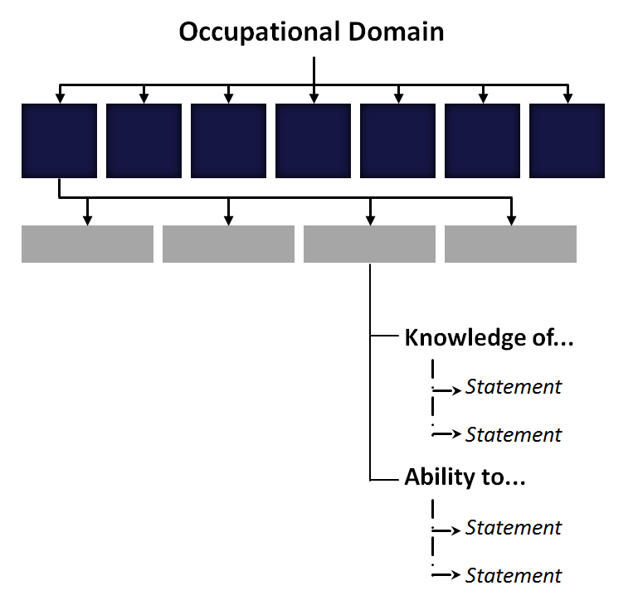
Norm Referencing Data informs Scope
Linked to:
Objectives
Structure
Specificity
EXAMPLE
What are the objectives/ uses for the standard?
Who are the key stakeholders?
What should all the major categories be?
What are the necessary related skills for each category?
And the subskills?
And how much detail and context is needed?
Notes:
The norm referencing should help to clarify some of the important questions.
What are the objectives/ uses for the standard?
Who are the key stakeholders?
What should all the major categories be?
What are the necessary related tasks for each category?
And the subtasks?
And how much detail and context is needed?
NOS should be developed as a response to sector needs. Understanding these sector
needs assists in prioritizing NOS development activities.

Slide 20
CERTIFICATION PROGRAMS, POLICY
WORKER MOBILITY
Information to support measurement of people
TRAINING PROGRAMS
CURRICULUM DESIGN
QUALIFICATION FRAMEWORKS
ARTICULATION
Information specific to an occupation or profession; program objectives
HR PRACTICES, e.g.
JOB DESCRIPTIONS
TRAINING PLANS
SELECTION CRITERIA
ORGANIZATIONAL DEVELOPMENT
Information specific to one job context
CAREER INFO/ CAREER PATHING
JOB ADVERTISEMENTS
General descriptions
Specificity, Contextual Information
Getting the Right Amount of Detail, Context
Notes:
The intended use of the occupational standard will determine the level of detail it requires.
Occupational standards developed to support the development of a job description might include a clearly defined job definition and contextual information about related tasks, while occupational standards developed to support a personnel certification program may involve distinct tasks, sub-tasks, and measurable competencies
The more specific the information that is contained in the Occupational Standard the larger the variety of uses.

Slide 21
STAGE
STAGE
STAGE
STAGE
STAGE
STAGE
1
2
3
4
5
6
STAKEHOLDER CONSULTATION, PROFILING ACTIVITIES
WHAT
Getting input and opinion from subject matter experts
WHY
Inform content and scope
SMEs?
‘High performing, experienced’ job incumbents
Academics or researchers specializing in the field
Specialists associated with part of the domain
Policy specialists
HOW
Facilitated group sessions (in person)
Surveys
Structured interviews
Direct observation
Notes:
Subject Matter Experts are fundamentally high performing workers in the occupation. Also other possible experts, e.g. academics or researchers that specialize in the field. May be accomplished authors who write about the field, or instructional designers.
Perhaps it’s specialists in certain aspects of the work
Methods can be of different forms, for example:
Surveys
Structured interviews
Facilitated focus group/stakeholder sessions
Literature reviews
Direct observation methods

Slide 22
STAGE
STAGE
STAGE
STAGE
STAGE
STAGE
1
2
3
4
5
6
SECONDARY, CORROBORATING RESEARCH
WHAT
Getting further information/data from qualified sources to address gaps
WHY
Ensuring data collected from existing sources is accurate,
complete
Obtaining additional data to address areas where there is a
need, e.g. deficiencies
HOW
Literature review
Structured interviews
Notes:
Contractor will look for further information/data from qualified sources to address gaps
Can take place through Literature review, structured interviews.

Slide 23
STAGE
STAGE
STAGE
STAGE
STAGE
STAGE
1
2
3
4
5
6
VALIDATION
WHAT
Quality assurance process to verify content integrity involving broad, representative SME consultation
WHY
Verify content integrity
Establish confidence (trust) in content; get buy in
HOW
Facilitated consultation with SMEs, e.g. review meeting,
on-line surveys
Secondary research, e.g. check sources
Notes:
Quality assurance process to verify content integrity involving broad, representative subject matter expert consultation
Facilitated consultation with subject matter experts, e.g. review meeting, on-line surveys

Slide 24
1
BASIC CONVENTIONS

Complete
Accurate
Appropriate specificity
Clarity, lack of ambiguity
Void of complex rhetoric,
jargon
Measurable, attainable
Void of redundancy
Harmony, agreement,
concordance, consistency
Focused on objective
Free of inherent bias;
politically neutral
Appropriate scope of domain


Validation Stages

Evidence of Application & Program Objectives

Content & Scope Integrity

ACCOUNTABILITY AND INFLUENCE MEASURES


QUALITATIVE REQUIREMENTS

BASIC CONVENTIONS

1
2
3

Validation Framework
Notes:
Subject Matter Experts will review the process to construct the standard to verify that the basic conventions have been followed.
Ensuring that the standard is:
Complete
Accurate
Appropriately specific
Clear
Avoids Jargon
Measureable, Attainable
Void of redundancy
Consistent
Focused on the objective
Free of inherent bias
Appropriate scope of domain

Slide 25
2
QUALITATIVE REQUIREMENTS

Verification of appropriate data
sources and collection
methods (primary, secondary)
Appropriate projection e.g.
current versus future/
aspirational
Appropriate Level/ Benchmark
Cross-validation with related
skills index, e.g.
Occupational Language
Analysis
Essential Skills Profile
Regulations
Qualified norm references

Validation Stages
Evidence of Application & Program Objectives

Content & Scope Integrity

ACCOUNTABILITY AND INFLUENCE MEASURES
QUALITATIVE REQUIREMENTS
BASIC CONVENTIONS
1
2
3
Validation Framework
Notes:
Data sources and collection methods are verified
The level of the standard is appropriate for the current conditions of the occupation
The standard is cross validated with any related tasks indexes.

Slide 26
3
ACCOUNTABILITY AND INFLUENCE

Evidence / demonstration that
standard fits need, e.g.
Assessment of people:
-- informs testing
specifications/
blueprint-specificity
supports test item writing,
validation
Curriculum development:
-- learning outcomes
-- instructional design
Evidence the standard
supports the context, e.g.
Applicable in range of
intended contexts (work
environments, countries…)
Validation Stages
Evidence of Application & Program Objectives
Content & Scope Integrity
ACCOUNTABILITY AND INFLUENCE MEASURES
QUALITATIVE REQUIREMENTS

BASIC CONVENTIONS
1
2
3
Validation Framework
Notes:
The proposed standard
Demonstrates that the standard fits the needs identified
The standard is applicable in a number of work environments.

Slide 27
STAGE
STAGE
STAGE
STAGE
STAGE
STAGE
1
2
3
4
5
6
RATIFICATION
WHAT
Advisory committee (policy and decision makers) verify due process (quality standards) followed
WHY
Verification and sign off that objectives met, due
process followed, i.e. compliance with quality
standards
Mechanism for endorsement of the standard
Due Process?
Agreed-upon principles (12) followed, e.g.
representation achieved
consensus approach used
Validation (content and scope integrity) achieved, e.g.
verification that qualified
data sources used
basic conventions met
HOW
Sign-off form
Notes:
Advisory committee (policy and decision makers) verify due process (quality standards) followed
Verification and sign off that objectives met, due process followed, i.e. compliance with quality standards
This can been a mechanism for endorsement of the standard

Slide 28
STAGE
STAGE
STAGE
STAGE
STAGE
STAGE
1
2
3
4
5
6
EDIT, TRANSLATE, PUBLISH
WHAT
Substantive edit, adaptation to second official language, and design work to achieved publish-ready document
WHY
Prepare for launch/broadcast
AND…
Identification of opportunities:
programs, products, services
markets, key accounts…
Promotion and marketing considerations
Fulfilment requirements: storefront et al
Notes:
Substantive edit, adaptation to second official language, and design work to achieved publish-ready document

Slide 29
Child Care Administrator
National Occupational Standards
Child Care Development & Care
Collaborate with Others
Human Resources
Financial Management
Develop and implement children’s programs
Protect and respect the rights of children
Collaborate with others
Hire staff
Manage staff
Prepare budget
Manage revenues and expenditures
Operations
Health and Safety
Leadership
Communi- cations
Manage legal requirements
Participate in planning activities
Manage administration
Manage equipment and facilities
Create a safe and healthy environment
Oversee nutrition program
Oversee security and emergency response
Provide leadership
Use communications skills
8 Sections
16 Tasks
68 Subtasks
Notes:
The process was highly consultative – driven by the sector. The focus is on what administrators do and the skills and knowledge associated with that. The whole development committee was made up of actual administrators.
The full scope of the standard does not necessarily apply to everyone. It is inclusive and representative of the sector. However, it does reflect current practice, trends, and themes in the sector
Trend in the field: Centres are hiring administrators from other sectors who have education/experience in business, management, etc. These people are then going back to school to study education and childhood development theory. Alternative is experienced ECEs moving into administrator role who needs to learn administration/management tasks.
The new Standard is organized in 8 sections containing 16 Tasks and 68 Subtasks.

Slide 30
Child Care Administrator
Child Care Development & Care
Collaborate with Others
Human Resources
Financial Management
Develop and implement children’s programs
Protect and respect the rights of children
Collaborate with others
Hire staff
Manage staff
Prepare budget
Manage revenues and expenditures
1.1 Implement a Philosophy of Early Childhood Education
and Care
1.2 Implement a Curriculum
1.4 Provide Programming Supports to Staff
1.5 Evaluate Programs
1.3 Provide a Child-Centred Learning Environment
Operations
Health and Safety
Leadership
Communi- cations
Manage legal requirements
Participate in planning activities
Manage administration
Manage equipment and facilities
Create a safe and healthy environment
Oversee nutrition program
Oversee security and emergency response
Provide leadership
Use communications skills
Notes:
Let’s take a closer look at the how this standard is broken down.
Task 1 is: Develop and implement children’s programs
This statement is broad, but no doubt essential to the occupation. Subtasks help to clarify the task be breaking the task down further.
1.1 Implement a Philosophy of Early Childhood Education and Care
1.2 Implement a Curriculum
1.3 Provide a Child-Centred Learning Environment
1.4 Provide Programming Supports to Staff
1.5 Evaluate Programs

Slide 31
Child Care Administrator
Child Care Development & Care
Required core knowledge:
Child care administrators know:
benefits of routines, transitions, planned activities, curriculum and appropriate equipment and materials
importance of:
- individualizes learning for each child
- meeting emotional needs of each child
- long periods of uninterrupted play learning
- family within the environment - respect for diversity of children and families
- staff’s role in enhancing children’s learning
- facility design and layout
- appropriate materials and equipment
- the outdoors and how it contributes to children’s
mental and physical health
legal requirements for indoor and outdoor areas of child care centres
Develop and implement children’s programs
Required skills and abilities:
Child care administrators are able to:
Ensure a caring and nurturing environment for all children
Maintain relationships with families, staff and children
Ensure staff understand their roles, for example, to:
Promote philosophy and core values of organization
Work as a team member...
Monitor the day-to-day activities in the organization:
Observe interactions in the learning environment
Document children’s learning
Create an environment of collaboration:
Help staff and families assess needs of child
Make suggestions for improvement...
Ensure facility and outdoor areas comply with legislative requirements
1.1 Implement a Philosophy of Early Childhood Education
and Care
1.2 Implement a Curriculum
1.4 Provide Programming Supports to Staff
1.5 Evaluate Programs
1.3 Provide a Child-Centred Learning Environment
K
P
Notes:
Let’s take a look at how the subtask will actually look in the standard.
Subtask 1.3 is to Provide a Child-Centred Learning Environment.
As you can see the standard itself actually gets quite specific by outlining the Core Knowledge, Skills, and Abilities that have been identified for an individual to meet the standard for providing a child-centred learning environment.

Slide 32
Additional Highlights
Child Care Administrator
National Occupational Standards
FAMILY and COMMUNITY involvement key in the research and development
Emphasis on LEADERSHIP and MANAGEMENT
PLAIN LANGUAGE and avoidance of redundancy
REORGANIZED with a focus on categorizing of skills
Added focus on BUSINESS PLANNING & DEVELOPMENT
FLEXIBLE, ADAPTABLE: represents a field of practice
Benchmarked against recognized practices
Added rich level of CONTEXT and SPECIFICITY
Notes:
New standards are collapsed and reorganized to provide clarity and readability
Emphasis on Leadership and Management includes what was formerly called governance and is now woven through the entire document.
This version has been worked to avoid redundancies, include common knowledge, and use plain language
Section G: Leadership – a good example – administrators play a key leadership role in the organization in the new standards
Family and Community has more explicit information on these services.
These standards and flexible and adaptable. They define a field of practice, what is expected of anyone who performs those tasks but we acknowledge that not all practitioners perform all tasks.
Key themes/focuses throughout: Family involvement, collaboration, accommodating diversity, inclusive practice

Slide 33
Additional Highlights
Child Care Development & Care
Child Care Administrator
Collaborate with Others
National Occupational Standards
Human Resources
= job role of the Child Care Administrator at sample facility
FAMILY and COMMUNITY involvement key in the research and development
Emphasis on LEADERSHIP and MANAGEMENT
PLAIN LANGUAGE and avoidance of redundancy
REORGANIZED with a focus on categorizing of skills
Financial Management
Operations
Health and Safety
Added focus on BUSINESS PLANNING & DEVELOPMENT
FLEXIBLE, ADAPTABLE: represents a field of practice
Benchmarked against recognized practices
Added rich level of CONTEXT and SPECIFICITY
Leadership
Communi- cations
Notes:
So for a person’s specific role in any one operation. This diagram illustrates the general concept. This is an outline of what the standard contains the eight sections and the sixteen task areas and so you can imagine that people will make decisions on what applies to them. If we use a single role this is what it could look like.

Slide 34
+Profiles
7 major tasks
18 sub-tasks
9 major tasks
29 sub-tasks
Infant
School Age
Facilitate the development and behaviour of infants
Develop, implement and evaluate programs
Support the holistic development of infants
Meet health, safety and well-being needs
Meet nutritional needs
Operate and maintain facilities
Advocate for the profession
Facilitate the development and behaviour of children
Develop, implement and evaluate programs
Support the holistic development of children
Meet health, safety and well-being needs
Meet nutritional needs
Guide children’s behaviour
Develop and maintain a safe environment
Use digital technology
Collaborate with schools
Notes:
School-age specific enhanced standards
If a task doesn’t apply to school-age care, the task will not show up in the document.
This school age profile in particular has two key areas reflecting changes in the sector.
Sub-Task A1.9 focuses on facilitating development of social responsibility.
Sub-Task A1.10 focuses on detecting and addressing bullying.
The School Age Profile follows the same process as the National Occupational Standards but this document has a very narrow focus and is very specific to work context.
The school age profile can be used in similar ways to the National Occupational Standards, however, in situations where the tasks of an ECE will deal exclusively with school age children this document would be more appropriate.
Similar to the School Age Profile the infant care profile is a set of infant specific enhanced standards
These are still based on the ECE standards, but if a Task or sub-task does not apply to the care of infants it will not be included.

Slide 35
Title Here and Here
Title Here and Here
Title Here and Here
Title Here and Here
Title Here and Here
Working with the Standards
Job Descriptions
Certification Program
Performance Appraisals
Prior Learning Assessment
Learning Outcomes
1
2
3
4
5
Notes:
As we mentioned previously there are over 100 uses for National Occupational Standards.
Obviously this would be a very long workshop if we were to tackle all of them.
We have developed seven activities as part of this workshop to demonstrate some of the more common uses of standards in the workplace.
Due to time restraints we will only be working with two of the activities today, however everyone in this workshop may have access to the other activities and I encourage to explore how to use standards through them.
The uses that we have outlined for the purposes of this workshop are:
Writing Learning Outcomes
Performance Appraisals
Developing Job Descriptions
Workplace Assessment
Career Mapping
Prior Learning Assessment
Developing a Certification Program
Based on the experience in the room I think the best activities may be - (varies depending on audience).

Slide 36
Learning Outcomes, Curriculum
And the Link to Learning Taxonomies...
How have you created learning outcomes for your courses in the past? What are they based on?
Based on your past experience how would a document like the National Occupational Standard assist you with creating learning outcomes?
1
Notes:
Ask the participants:
How have you created learning outcomes for your courses in the past? What are they based on?
Based on your past experience how would a document like the National Occupational Standard assist you with creating learning outcomes?

Slide 37
Learning Outcomes, Curriculum
And the Link to Learning Taxonomies...
Learning taxonomies help educators make decisions about how their students will learn, and how that learning can be assessed
Learning outcomes should be clear which levels of accomplishment are envisaged for the learner
1
Notes:
Key Messages:
Academic programs have two key purposes: to prepare students for further learning, and to prepare students for the workplace. The emphasis on these two purposes varies by program.
Thus programs whose main purpose is preparation for employment will want to ensure students learn to apply knowledge and abilities to the greatest extent possible through appropriate learning strategies in the classroom and in the workplace.
As well, the learning outcomes for that program will specify the application of knowledge and skills to the appropriate level within the program. The process of using standards to inform curriculum can extend beyond the outcome development stage to designing assessment, instruction, and structuring work placement/co-op assignments
Participants from across the country and with varying levels of experience and expertise were involved in the development of the Occupational Standards. Involving a cross-section of the workforce in the development process helped to ensure that the Occupational Standards for Child Care Administrators and the School Age Profile are Pan-Canadian in nature rather than reflective of a single province, jurisdiction, or approach to early childhood education and care.
Students entering post-secondary programs immediately after completing secondary school are not likely to perform at the advanced level of abilities as defined in the standard. Sector experience is required to reach the advanced levels of proficiency of many skills.

Slide 38
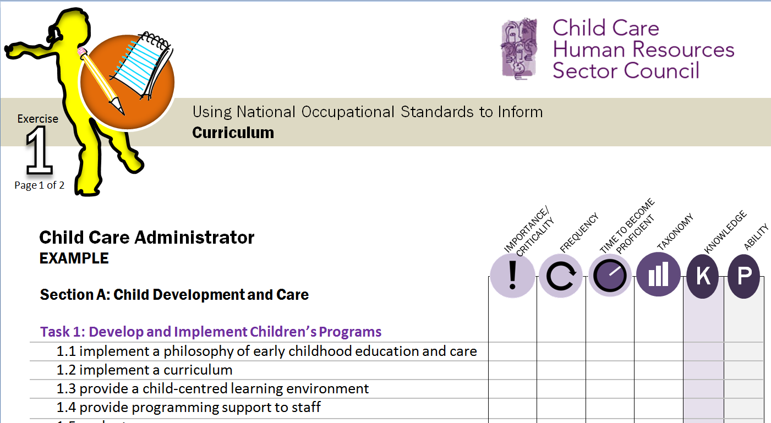
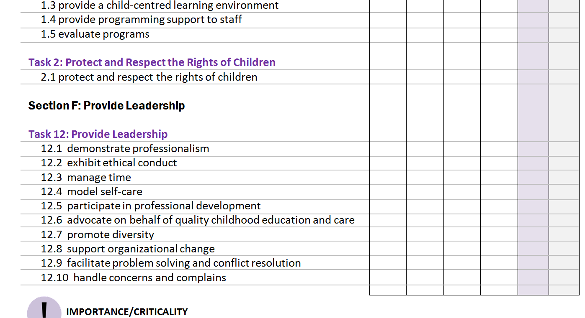
1
Notes:
Mapping Occupational Standards is a useful exercise that can be used to assist instructors hired for their backgrounds who may have limited experience in designing and developing programs and courses.
The goals of exercises like this are to help educators:
- benchmark existing programs and courses against recognized sector standards, and
- develop programs and courses that help learners to meet expectations in a progressive manner.
Professionals know their field and the required knowledge and abilities to be successful in the field. This information is presented in the National Occupation standards and the school age profile. The intent of this exercise is to provide ideas and tools that will allow educators to incorporate standards within their curriculum to provide relevant and quality programming to the benefit of their students, institution, and the profession.

Slide 39
Adapted Blooms Framework
KNOWLEGE
SKILLS/PERFORMANCE
K1
Remembering
S1
Awareness
K2
Understanding
S2
Readiness
K3
Applying
S3
Basic Proficiency
K4
Analysing
S4
Professional Proficiency
K5
Evaluating
S5
Adaptable Proficiency
K6
Creating
S6
Creative Proficiency
Notes:
Bloom's Taxonomy is a classification of learning objectives within education proposed in 1956 by a committee of educators chaired by Benjamin Bloom who also edited the first volume of the standard text.
The Taxonomy has been further developed, but most recently the Canadian Tourism Human Resource Council went through an exercise to create an adapted taxonomy for use with National Occupational Standards.
There are other learning taxonomies could be used – this is an example that is being used by some sector related programs.

Slide 40
Applying the Occupational Standard to Inform
Learning Outcomes, Curriculum
How much?
What level?
What tasks should be performed to be competent?
How does the existing program compare to the workplace requirements?
How does the program compare to other programs (training, certification)?
How does the existing program compare to the workplace requirements?
How does the program compare to other programs (training, certification)?
How much?
What level?
What tasks should be performed to be competent?
Notes:
By using standards to inform curriculum you can help to answer questions like:
How much time do you allocate to a task in the program?
What level?
What tasks should be performed to be competent?
How does the existing program compare to the workplace requirements?
How does the program compare to other programs (training, certification)?
Education and Training organizations benefit from standards as they provide:
benchmarks against which to develop courses and programs
recognition from the sector as being accountable and responsive to their expectations
a comprehensive description of the field of practice to help identify and promote program specializations
common benchmarks on which to base articulation and transfer of credit agreements

Slide 41
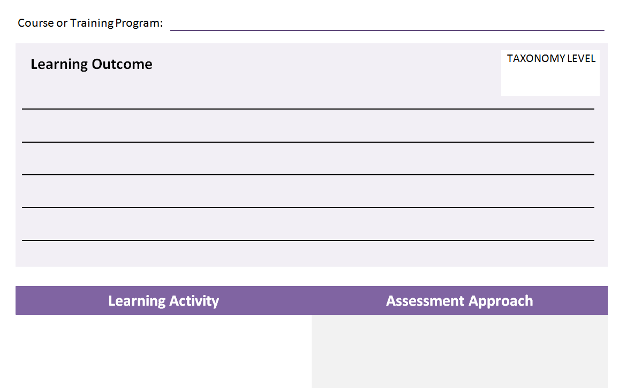
Learning Outcomes
ACTION VERB : How
MEASURABLE OUTCOME : What
and sometimes
CONDITIONS : Why, or What
Comprehensible
Appropriate
Attainable
5/6
Possible Learning Outcome:
By the end of this course participants will be able to:
Construct policies and procedures for emergency situations
Learning Objectives Supporting the learning outcome:
By the end of this course participants will be able to:
Develop emergency policies and preparation
Identify possible community partners for assistance in emergency situations
Develop an emergency response plan
Develop an emergency communication plan
Develop a reporting and recording process
Task 14: Oversee Security and Emergency Response
14.1 implement security measures
14.2 prepare for emergency situations
14.3 respond to incidents and emergencies
Notes:
Active – it describes what students can do
Comprehensible – students know what it means
Appropriate – to the student’s current goals and career plans
Attainable – most students will mostly meet it, with due effort
Assessable – we can see if it has been achieved
For those of you who are not familiar a Learning Outcome states what a person should be know or be able to do after a learning experience. Learning outcomes begin with an action verb and describe something observable or
measurable. Outcomes may be further broken down into objectives for a particular lesson or part of a general topic.
A couple of tips on Learning Outcomes:
Avoid vague verbs that are hard to assess
Use only one verb per learning outcome
Make sure the outcome reflects the level of learning
Write the outcomes in terms of what the learner will be able to do as part of the course or workshop
If we take a look at the Child Care Administrator Standard.
Task 14: Oversee Security and Emergency Response
14.1 implement security measures
14.2 prepare for emergency situations
14.3 respond to incidents and emergencies
Looking at the criticality elements of this Task we can determine that this is a fairly important duty of any Child Care Administrator.
Let’s take a closer look at Sub-Task 14.2 to use as an example. The word “prepare” is in the sub-task but taking a look at this statement and in the context in the Child Care Administrator Standard preparing for emergency situations is more than simply buying a first-aid kit. The description of the sub-task requires that the administrator know policies, and be able identify and react to emergency situations. This would be a higher level with in the taxonomy likely requiring learning objectives for the outcome at a Level 6 Creating and Level 5 Evaluating.
One important aspect to remember is the level the standards are written at. It is very unlikely that any course will be able to produce students that can fully meet the standard, however course can prepare students to meet the standard.
Possible Learning Outcome:
By the end of this course participants will be able to:
Construct policies and procedures for emergency situations
Learning Objectives Supporting the learning outcome:
By the end of this course participants will be able to:
Develop emergency policies and preparation
Identify possible community partners for assistance in emergency situations
Develop an emergency response plan
Develop an emergency communication plan
Develop a reporting and recording process
Facilitator note:
Information from the standard.
Sub-Task 14.2 Prepare for Emergency Situations
Required core knowledge:
Child care administrators know:
policies and procedures, e.g. testing fire alarms, fire drills, evacuation plans, emergency telephone numbers, earthquake drill
Required skills and abilities:
Child care administrators are able to:
identify potential emergency situations, e.g. fire, flood, natural disaster, power outage, medical
work in partnership with community to minimize risks, for example:
discuss potential situations and procedures with authorities, e.g. emergency response team
develop emergency response plans, including, for example:
type of emergency
staff responsibilities
evacuation procedures
first aid and emergency kits
muster point or gathering place
train staff in emergency response plan, including:
use of equipment, e.g. fire extinguisher
communicate emergency procedures to families, e.g. off-site emergency contact information
ensure staff and children practice emergency procedures, e.g. fire drills, lockdowns
establish system for reporting and recording incidents
assign responsibility to others in case of absence of the administrator

Slide 42
Using standards to design curriculum and develop learning outcomes
Exercise
1
LEARNING OUTCOME
Using a skill statement from the standards, write a learning outcome that would be at an appropriate level for your course or program.
Indicate the taxonomic level for knowledge and/or performance.
LEARNING ACTIVITIES, LEARNER ASSESSMENT
Discuss activities that you could use that would help students learn this skill
Discuss how you would assess the skill so that students are able to demonstrate achievement of the outcome and competence against the standard
Notes:
Facilitator information:
Break the room into small groups of 2 to 3 people. Provide participants with a sample section from the CCA standards or one of the profiles, and the worksheet. Have participants select a competency and use as an example, walking through the steps to determine level of the standards.
Ask participants:
Consider how this competency might look in their course or training program?
What level is it taught at?
Is there practice involved, and if so how much?
What level of knowledge and performance are expected of learners?
Based on this discussion, allow participants 10 minutes to develop a learning outcome that addresses this competency and is appropriate for their course or program – consider the proficiency and experience of the learner, the context of the program (time, scope, resources, instructor experience, program objectives, etc.).
Using a task statement from the standards, write a learning outcome that would be at an appropriate level for your course or program. Please indicate the taxonomic level for knowledge and/or performance.

Slide 43
Mapping Course Outcomes Against Occupational Standards: A gap analysis tool
Broader Content Area, Higher Level
Narrower Content Area, Lower Level
No Comparable Areas
Same Content Area, Higher Level
Equivalent
Broader Content Area, Lower Level
Narrower Content Area, Similar Level
Similar Content Area, Broader Scope
Narrower Content Area, Higher Level
Same Content Area, Lower Level
HIGH
LOW
LEVEL
NARROW
SCOPE
BROAD
Notes:
Let’s use this quick tool to help debrief the learning outcome activity.
This is simple chart that charts the level and scope of a learning outcome against the standard. You can illustrate this comparison by determining which of these nine boxes the your learning outcome would fall into.

Slide 44
Using standards to design curriculum and develop learning outcomes
Exercise
1
DEBRIEF
What evidence would you look for that your learners have achieved this outcome?
How can the standards help you determine this?
Is there an opportunity for workplace practice and assessment?
How would you conduct the assessment of this competency/learning outcome, again considering the context of your program and the learners you are working with?
Return
Summary
Notes:
Ask Participants:
What evidence would you look for that your learners have achieved this outcome?
How can the standards help you determine this?
Is there an opportunity for workplace practice and assessment?
How would you conduct the assessment of this competency/learning outcome, again considering the context of your program and the learners you are working with?

Slide 45
Performance Appraisals
What constitutes a good quality performance appraisal process?
What needs to be measured and how? Is it valid and reliable?
Why is it important to do performance appraisals?
What performance appraisal tools do you currently use in your workplace?
How were these tools developed? What are they based on?
2
Notes:
Ask Participants:
What constitutes a good quality performance appraisal process?
What needs to be measured and how? Is it valid and reliable?
Why is it important to do performance appraisals?
Performance appraisals are very useful everyone. They can acknowledge superior performance and strengths and provide a foundation for career planning and professional development. Performance appraisals should be tailored to address the professional skills development level, maturity and experience.
What performance appraisal tools do you currently use in your workplace?
How were these tools developed? What are they based on?
The ability in each task is measured against the Occupational Standards which are recognized as a ‘current practice’

Slide 46
Performance Appraisals
EXCEEDS/MEETS STANDARDS
DEVELOPING PERFORMER
HUMAN RESOURCES
HIRE STAFF according to standard:
4.1 Determine staff needs
4.2 Recruit staff
4.3 Interview prospective staff
4.4 Screen prospective staff
4.5 Offer best position to best candidate
4.6 Provide orientation to new staff
NOTES:
PROFESSIONAL DEVELOPMENT PLAN:
DOES NOT APPLY
UNSATISFACTORY
IMPROVEMENT REQ’D
SOLID PERFORMER






2
Notes:
Key Messages:
Framework against which performance can be objectively and fairly assessed and upon which professional development activities can be planned.
Performance appraisals are very useful for both the supervisor and the employee. They can acknowledge superior performance and strengths and provide a foundation for career0.
Planning and professional development.
Performance appraisals should be tailored to address the professional tasks development level, maturity and experience of the employee.

Slide 47
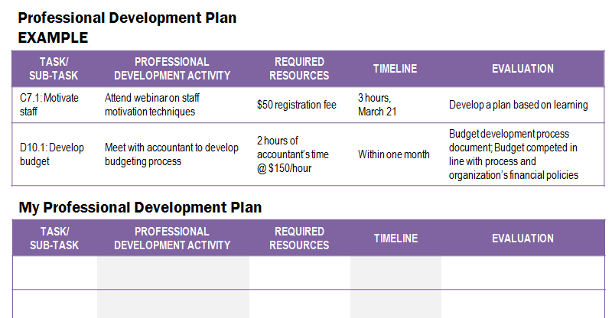
Using standards to develop workplace assessment materials and training plans
Exercise
Four key steps in conducting a performance appraisal:
2
Select Method
Develop Forms
Prepare for Interview
Conduct Review
Notes:
Four key steps in conducting a performance appraisal can include:
Select a performance rating scale or method
There are a number of scales that can be used for appraising performance. Some scales will assign levels (e.g., Level 1, 2 and 3), some will assign titles (e.g., expert, competent, some experience, no experience) and others will assign letters (A, B, and C).
What is important for any performance appraisal scale is that the criteria for each ordinal are clearly defined, measurable and performance-based.
2. Develop performance appraisal forms
It is important that the appropriate Tasks and Sub-Tasks are selected based on each work situation to ensure that the individual’s performance appraisal is reflective of the activities that they perform.
The Performance Appraisal form will typically contain a section for each applicable Task within the Occupational Standards. For each Task, the applicable Sub-Tasks can be summarized and identified as performance indicators.
Competency for each Task will be measured using the rating scale defined for the appraisal.
3. Prepare for the performance appraisal interview
The key element of a performance appraisal is the interview. However, there is preparation involved for both the employee and the supervisor prior to the interview.
Prior to the Performance Appraisal Interview, the employee uses the performance appraisal for self-reflection. Once the self-reflection is completed, the form is returned to the supervisor for use during the Performance Appraisal Interview.
4. Conduct the performance appraisal interview
One of the most significant features of performance appraisals is that they require interaction between the supervisor and the employee.
The Performance Appraisal Interview serves as a catalyst for meaningful discussion of job performance which leads to mutual understanding and appreciation.
During the Performance Appraisal Interview the appraisal must be confirmed, which requires a high degree of trust and communication. They must feel comfortable in sharing their explanations for their self-reflection and the supervisor must also be open to discussing reasons why their performance rating for specific Tasks may differ.
The discussion of current performance, will lead to several positive outcomes including setting goals and objectives for the next review period and identifying areas for additional training and professional development.
All goals should be SMART (Specific, Measurable, Attainable, Realistic and Timely). Setting SMART goals to determine if goals have been met each year and can help to address specific programs or employment requirements or responsibilities.

Slide 48
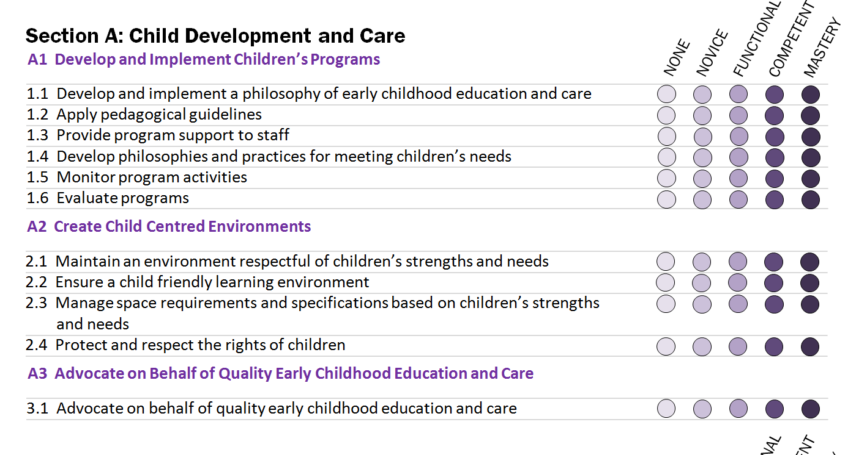
2
Notes:
Facilitator Information:
The Facilitator will distribute the updated CCA Checklist to the group. The workshop participants will examine their own practice using portions of the CCA NOS and updated portions of the Child Care Administrator Checklists.
This is an individual activity; however, participants should feel free to discuss the activity with those around them.
Key Messages:
Fortunately the CCHRSC has in the past paired with the Early Childhood Community Development Centre to create two documents based on the ECE and CCA standards. With the update to the CCA standard the current document will be out of date, but it is easily updated.
For the purposes of this activity we will be asking you to do some self reflection on your own practices. You have been provided with a copy of the relevant material from the standard as well as updated materials based on the CCHRSC/eccdc document. Using these materials you can take some time to do some self assessment. If you are not a Child Care Administrator than I would still like you to take a look at this process and comment on how you think the standard and this document could assist in the performance appraisal process.
After approximately 10 minutes (it is alright if they do not finish) the discussion will come back to the larger group and the facilitator will debrief the activity.

Slide 49
Using standards to develop workplace assessment materials and training plans
Exercise
2
DEBRIEF
After going through this process would you consider this an objective and fair method of assessment?
How are performance appraisals, like this one, useful for both the supervisor and the employee?
Return
Summary
Notes:
Ask Participants:
After going through this process would you consider this an objective and fair method of assessment?
How are performance appraisals, like this one, useful for both the supervisor and the employee?
Performance appraisals should be tailored to address the professional tasks development level, maturity and experience of the employee.

Slide 50
Job Descriptions/Job Ad
What is the purpose of job description?
Who has experience writing a job description?
How would you determine which skills were needed, or might be needed?
For employees, how would you determine which skills you need to advance in your career?
3
Notes:
Ask Participants:
What is the purpose of job description?
A number of answers are possible. A key purpose of job descriptions is to provide a clear and accurate description of job expectations and priorities. Job descriptions should be based on close examination of the job in question and provide the employer and candidates an understanding of what skills and abilities are needed in the role. This helps employers select qualified candidates and it helps candidates determine if they have the skills and experience required for the job.
Who has experience writing a job description?
How would you determine which skills were needed, or might be needed?
For employees, how would you determine which skills you need to advance in your career?

Slide 51
Job Descriptions
HUMAN RESOURCES
HIRE STAFF according to standard:
4.1 Determine staff needs
4.2 Recruit staff
4.3 Interview prospective staff
4.4 Screen prospective staff
4.5 Offer best position to best candidate
4.6 Provide orientation to new staff
3
Notes:
This is a sample from the CCA standards that addresses the recruitment and selection of staff (Section C: Human Resources; Task 4: Hire Staff):
Task 4: Hire Staff:
Determine Staffing Needs
Recruit Staff
Interview Prospective Staff
Screen Prospective Staff
Offer Position to Best Candidate
Provide Orientation to New Staff
Note that recruiting staff is a major responsibility of child care administrators working in centre-based settings; however, home-based child care providers may or may not hire staff.

Slide 52
Job Descriptions/Job Ad
Job title
Conditions of employment (permanent, full time, etc)
Salary / Wage (annual / hourly)
Start date
Location of employment
Education required
Experience
Languages (spoken, read, written)
Work settings (e.g. not-for-profit, indoor/outdoor)
Business equipment/tools to be used
Technical knowledge
Areas of specialization within the occupation
Any other specific skills
Security and safety requirements
Transportation
Work conditions and physical capabilities
✓
✓
✓
✓
✓
3
✓
✓
✓
✓
Notes:
Job description generally contains what we see on the screen. The bolded items are items that can be informed by the standard.
For each employee, a good job description helps the incumbent understand:
Their duties and responsibilities
The relative importance of their duties
How their position contributes to the mission, goals and objectives of the organization
For the organization, good job descriptions contribute to organizational effectiveness by:
Ensuring that the work carried out by staff is aligned with the organization's mission
Helping management clearly identify the most appropriate employee for new duties and realigning workloads
Job descriptions are also the foundation for most HR management activities:
Recruitment, Selection, Orientation, Training, Supervision, Compensation, performance management, legal defence

Slide 53
Using standards to develop a job description
Exercise
3
WRITING A JOB DESCRIPTION
Define the purpose of the job
Outline the key responsibilities of the job
Indicate required education and experience for the job
State required licenses, credentials, or memberships
Notes:
The steps are:
1.Define the purpose of the job
This section provides a snapshot of the occupation in 3-4 sentences and is very useful to include in job advertisements.
This section typically includes:
An overview of the key job responsibilities;
The level of supervision and management received (also who the position directly reports to)
2.Outline the key responsibilities of the job
This section describes the essential responsibilities of the job and is the most important section of the job description.
It is important to note that this section will not outline every responsibility and task that in the standard.
Instead, this section will outline the main responsibilities of the position.
This information can be obtained from the Tasks and Context Statements within the Occupational Standards.
3.Indicate required education and experience for the job
This section describes the educational background as well as specific knowledge, skills and abilities that are required to perform the responsibilities of the job.
Clearly state when specific education and experience requirements are essential versus desirable.
Specific knowledge requirements for the position can be extracted from the Required Core Knowledge section of the Occupational Standards.
4.State required licenses, credentials, or memberships
This section specifies any additional licences, certifications or registrations that are required.
These requirements will be specific to each workplace and may include provincial regulatory body or association, police and child protection record checks, and CPR and first aid certification.

Slide 54
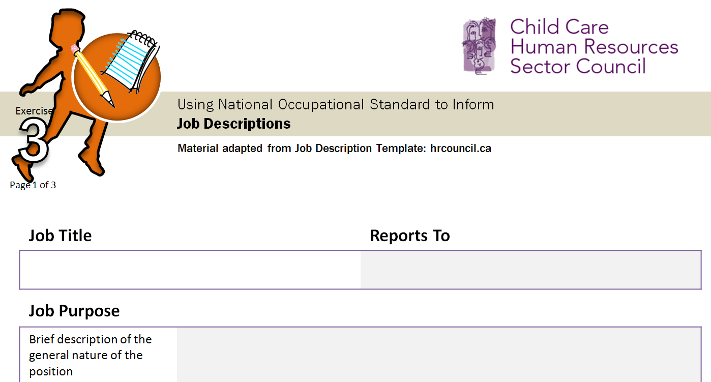
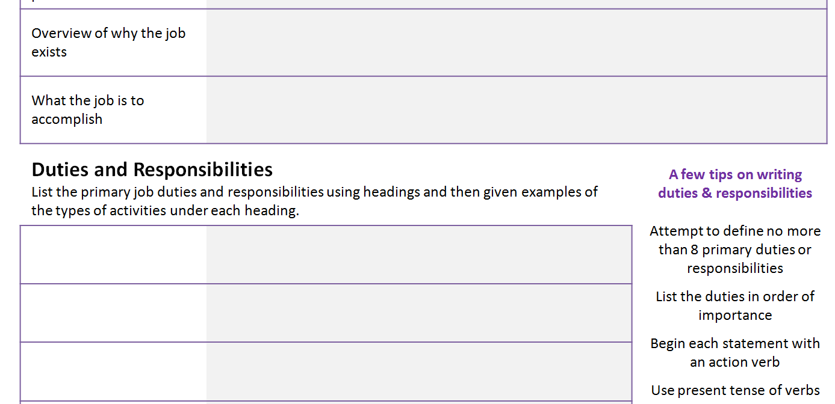
3
Notes:
Facilitator Information:
In small groups of 2-3 participants will go through the template provided and create a job description based on either the school age care, or infant care profiles.
Key Messages:
Our objective for the activity is to use National Occupational Standards to develop accurate and effective job descriptions
The standards may indicate or be used to determine: education requirements, experience requirements, description of the work setting, equipment or tools that are to be used, technical knowledge, descriptions of specializations within the occupation, security and safety requirements, work conditions and physical capabilities, specific skill requirements and level of proficiency.

Slide 55
Notes:
If time allows, distribute the two poorly written job descriptions to the participants. Groups will have 10 minutes to review job descriptions, and use the Standards and/or profiles and the worksheet provided to rewrite the job description.

Slide 56
Using standards to develop a job description
Exercise
3
DEBRIEF
Having completed the job description activity, how did your group use the skill profile to create the job description?
Where there elements your group added, or chose to disregard from the profile?
What information was missing?
What else would you need to include making this job description clear and accurate?
Return
Summary
Notes:
Facilitator Information:
Small groups will report back on the creation of the job description. If there was time to complete the second exercise they can report on what they changed and why, and reflect on the value of having clear and accurate job description for a range of HR practices.
Ask Participants:
Having completed the job description activity, how did your group use the skill profile to create the job description?
Where there elements your group added, or chose to disregard from the profile?
What information was missing?
What else would you need to include making this job description clear and accurate?

Slide 57
STAGE
STAGE
Using Standards for Prior Learning Assessment
Ask Participants:
What is a PLAR process?
How do participants currently use PLAR in their institution?
4
Notes:
Ask Participants:
What is a PLAR process?
PLAR may be known as another process, but from the Canadian Association of Prior Learning and Assessment: PLAR stands for Prior Learning Assessment and Recognition. It’s a systematic process through which you identify, assess, organize, describe and document your knowledge, skills and attitudes that have been developed:
through formal education and training
informally on the job, through independent reading and study, in courses taken in your community, in volunteer work, and through numerous other significant life experiences
How do participants currently use PLAR in their institution?

Slide 58
STAGE
STAGE
Using Standards for Prior Learning Assessment
PLAR
Identify what an individual knows and can do
Equate those skills and knowledge with specific standards or outcomes
Assess the individual against those standards or outcomes
Credit the learner in an appropriate manner
4
Notes:
Assessment is conducted to:
Identify what an individual knows and can do
Equate those skills and knowledge with specific standards or outcomes
Assess the individual against those standards or outcomes
Credit the learner in an appropriate manner.
Learners benefit from PLAR because they can:
Build on their experiences and avoid duplication of learning
Complete programs and earn recognition and credentials more efficiently
Focus on their development and training needs
Enhance their self confidence
Recognise the value of their accomplishments
Save time and money
The approach should be learner-centered in that it actively involves the learner or candidate in the process. It absolutely requires the use of standards and/or outcomes to provide clear, accessible, objective criteria against which learners and organizations can measure competencies. Standards are explicit, assessable (measurable), and related to occupational competence.

Slide 59
Using standards for prior learning assessment
Exercise
4
DISCUSSION
How do participants currently use PLAR in their institution?
Pre-Entry
Candidate Profiling
PLAR CASE STUDY
Determining PLAR for candidate
Determining criteria against which the evidence will be measured
Gathering, Generating Compiling Evidence
Assess-ment
Accreditat-ion
Post-Assess-ment Guidance
Notes:
PLAR Process
1. Pre-entry
Disseminating information about the process; provide adequate information to potential candidates
2. Candidate Profiling
Candidates reflect on their experiences and begin to develop a profile of their competencies; self-assessment may take place
3. Gathering, generating and compiling evidence
Candidates identify how to demonstrate their competence; gather sufficient and valid evidence of competencies
4. Assessment
Organisation or institution assesses the candidates evidence
5. Accreditation
Decision is made by organisation or institution about credit or recognition to be granted to candidate based on assessment of evidence supplied
6. Post-assessment guidance
Discussion with learner/candidate about process and what to do next

Slide 60
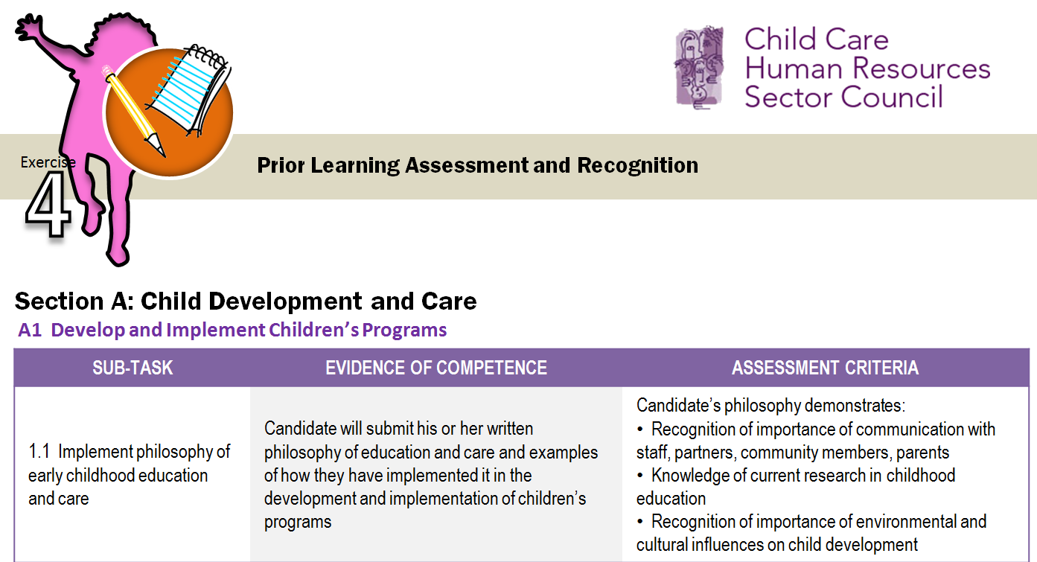
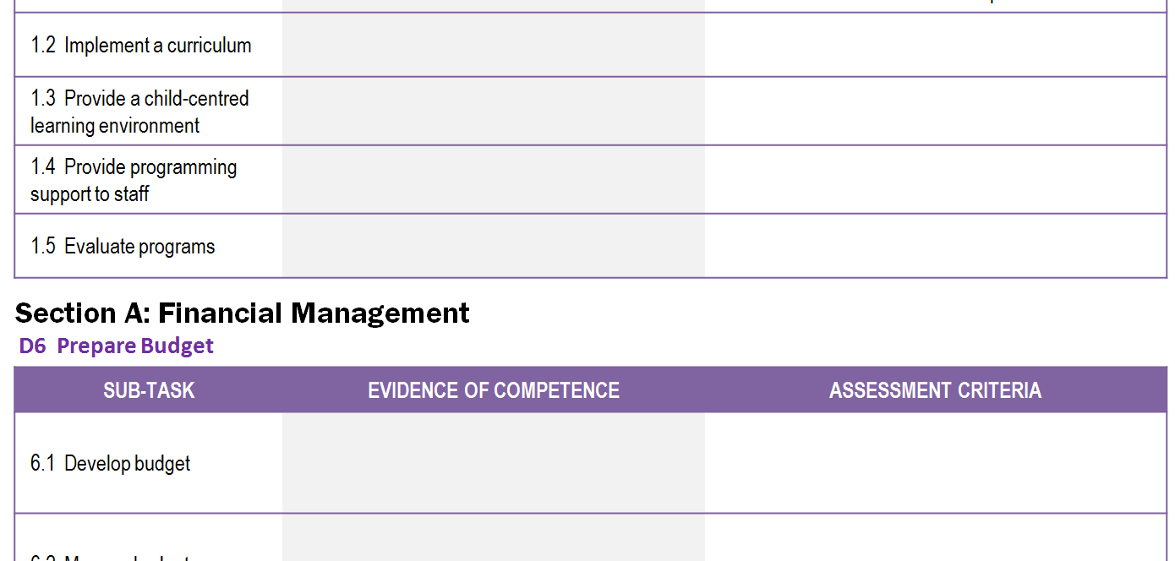
4
Notes:
Facilitator Information:
Propose two cases of a typical person who would like to have their prior learning assessed or recognised. One is seeking entry to the workforce; the other is seeking entry and credit to post-secondary. The objective is for participants to consider how they would manage a real life case and make an assessment of a candidate’s prior learning by using the standards.
Working in small groups, participants will determine the acceptable evidence required of the candidate in either CCA Standards Task 1: Develop and Implement Children’s Programs or CCA Standards Task 6: Prepare Budget.
Guiding questions:
What do the candidates need to provide evidence of?
What could the evidence look like? What, specifically, is the candidate expected to produce as evidence of their competence?
How will the evidence be submitted? To whom?
Small groups can decide which case they would like to examine. Participants will determine the criteria against which the evidence will be measured. These criteria can be derived from the sub-skills in the standards: the detailed descriptions of knowledge, skills, and attitudes.

Slide 61
4
DEBRIEF
Please share some examples of the criteria your group has established.
How does the evidence demonstrate that the standards or outcomes have been met?
Return
Summary
Notes:
Ask Participants:
Ask small groups to share examples of the criteria they have established.
How does the evidence demonstrate that the standards or outcomes have been met?
Key Messages:
A PLAR process should use standards and/or outcomes to provide clear, accessible, objective criteria against which learners and organizations can measure competencies.
Occupational Standards are useful as they are explicit, assessable (measurable), and related to occupational competence.

Slide 62
Certification Programs
In the past have you played a role in creating certifications, or assessments for certifications?
What did you, or your committee base your decisions around weighting of test items or tasks?
5
Notes:
Ask Participants:
In the past have you played a role in creating certifications, or assessments for certifications?
What did you, or your committee base your decisions around weighting of test items or tasks?

Slide 63
Certification Programs
Test Blueprint
Test Questions
A | B | C | D
15% | 11% | 12% | 20%
E | F | G | H
25% | 7% | 5% | 5%
When working with schools, child care administrators:
Reinforce policies and procedures used by child care centre
Determine school/program transition activities
Program activities considering school’s calendar
Liaise with external agencies and resources
5
Notes:
Key Messages:
Standards can be used as a basis to design certification programs. They are also used as a basis to be able to compare or articulate programs.
Two simple illustrations of what they can do are determining the testing blueprints – determining what people will be tested on and the weighting of the items.
For example when a Task is determined to be very important, performed frequently, and takes several years to perform proficiently a testing blueprint would likely identify that task as a priority and give it more weight. Overall, the certification program would assess practitioners at the right level in the right context.
Another practical use of the standards is to help develop the test questions. The illustration on the screen shows you how the statements contained here are directly coming from what is contained in the standard.
Where there is more than one certification program the standards can help identify how they are related and how they fit with the standards.
Certification programs are:
A voluntary process – the formal recognition of qualified person, who meets a standard
Sector-recognized credential granted to a candidate upon successful demonstration of occupational competence
Usually focus on competency: that is, indicating that the candidate has earned the credential because they demonstrated competency (proficient in the skills defined by the standards, including the applied knowledge)
Test blueprints are documents that contain necessary information to inform decisions on the assessment of candidates, and the important attributes of a test. Blueprints are also used to ensure that alternative forms of the examination are functionally equivalent.
Blueprints also provide direction for content developers when writing new items, facilitate evaluation of the appropriateness/effectiveness of the exam by content experts and stakeholders, and aid candidates in preparing for the examination.
A Test blueprint is comprised of structural and contextual variables.
Structural variables include those characteristics that determine general design and appearance of the exam. They define the length of the examination, the format or presentation of the questions, and special functions of the questions, e.g., cognitive domain, category weighting.
Contextual variables qualify the content domain by specifying the contexts in which the examination questions will be set, e.g., client type, age and gender, type of practice, or even geographical setting.

Slide 64
Adapted Blooms Framework
KNOWLEGE
SKILLS/PERFORMANCE
K1
Remembering
S1
Awareness
K2
Understanding
S2
Readiness
K3
Applying
S3
Basic Proficiency
K4
Analysing
S4
Professional Proficiency
K5
Evaluating
S5
Adaptable Proficiency
K6
Creating
S6
Creative Proficiency
Notes:
Key Messages:
Bloom's Taxonomy is a classification of learning objectives within education proposed in 1956 by a committee of educators chaired by Benjamin Bloom who also edited the first volume of the standard text.
The Taxonomy has been further developed, but most recently the Canadian Tourism Human Resource Council went through an exercise to create an adapted taxonomy for use with National Occupational Standards.
There are other learning taxonomies could be used – this is an example that is being used by some sector related programs.

Slide 65
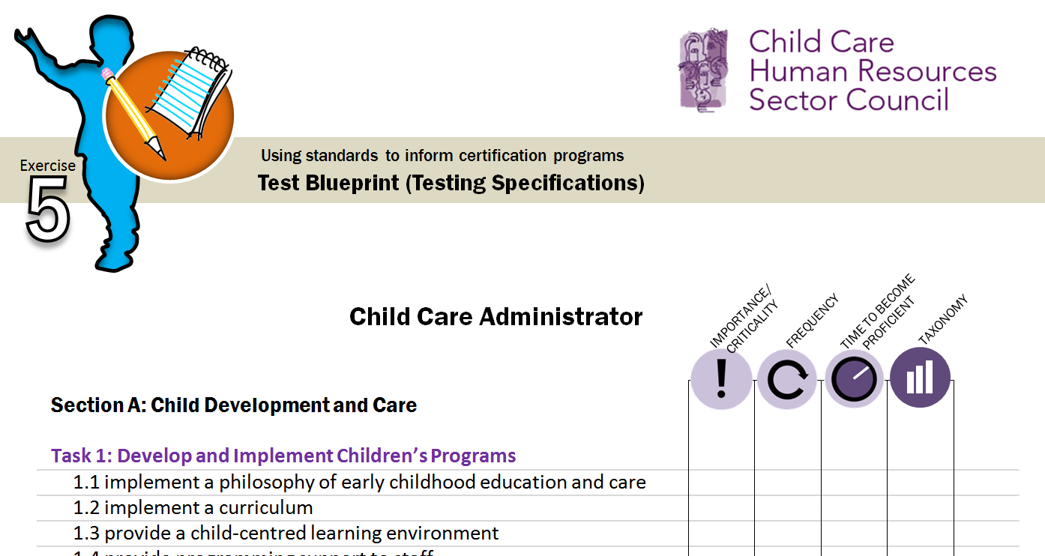
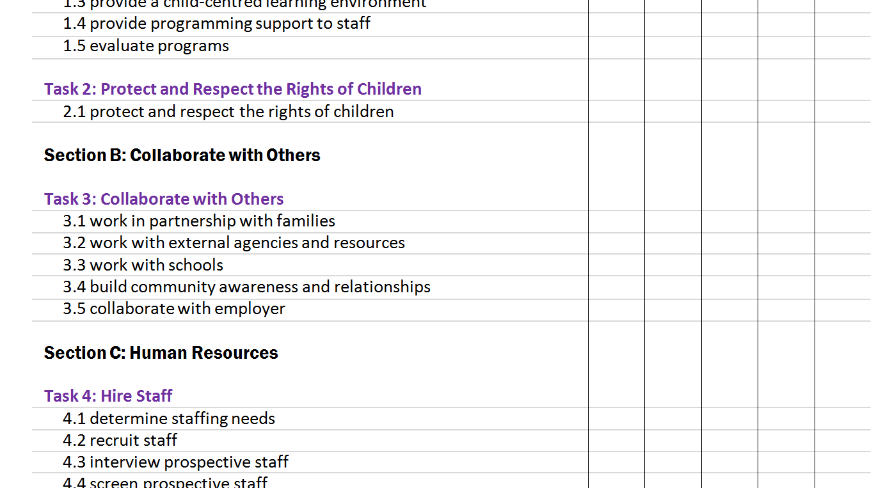
5
23
9
Notes:
Key Messages:
An important part of the blueprint is to establish how items are selected or sampled for inclusion on an examination. Standards deemed more important form the basis for a larger proportion of an examination. Conversely, standards that are less important might not be assessed or will have less significance or emphasis in the exam.
Although there are many assessment methods that standards can inform, it is common for certification schemes to include a multiple choice exam.
Weighting also should factor in a taxonomy: having questions of different levels of complexity that match the standard
Weighting is about assessing competency (and not the outcomes of learning) – so we want to be sure that weighting is not about matching a course outcome, but a measure of the domain of the standards.
Small Group Exercise (15 minutes)
Facilitator Information:
Distribute the reformatted Table of Contents for Test Weighting handout. In this exercise the participants will work in small groups to weight Task categories for a suggested 100 question multiple choice exam.
Divide the participants into small groups of two or three individuals. To prepare the test form, a decision on how many questions will come from each category needs to be made. Participants will agree on a number of questions, or weight, to be placed next to each task and why that weight is appropriate.
Once each group has decided how many questions need to be allocated to each task, they need to then move on to assigning questions to each sub-task. They may find that based on the contextual information provided they may need to re-examine their first weighting.
It is not expected that participants will complete this entire exercise in the time allotted. If participants do complete the weighting exercise, challenge their group to write some multiple choice questions to present to the large group.

Slide 66
Example
Multiple Choice Test Items
Why did John B. Watson reject the structuralist study of mental events?
 Stem
Distractors
A
He believed that structuralism relied too heavily on scientific methods.


He rejected the concept that psychologists should study observable behaviour.

B

Alternatives/ Options
He believed that scientists should focus on what is objectively observable.

C

He actually embraced both structuralism and functionalism.

D

Correct Answer (or Key)
Notes:
Key Messages:
From the Test weighting, and the standards multiple choice questions can be created.
If participants complete the question mapping exercise they can attempt to craft a possible multiple choice question.
A couple of tips of multiple choice questions.
A questions is made up of a stem and options or alternatives. Of the options there are distractors and one correct answer. Four options are ideal.
Create plausible distracters that would sound right to anyone who does not meet the standard but are clearly wrong.
Make the question as direct and clear as possible. Remember this is no a test of logic. So you use double negatives and complex structures. For this reason you should avoid using negatives
Make sure there is only one unambiguously correct response.
When possible, write stems as you would an open-ended question such that if a proficient individual were given the question stem they could write out the correct response.

Slide 67
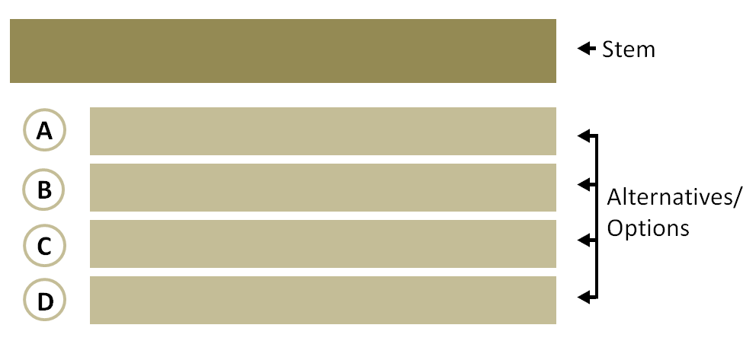
Multiple Choice Test Items
Quality Criteria
The stem must:
be meaningful and present one problem or task
present all relevant information to ensure clarity and understanding, and
should ask a complete question, state an issue, or present a scenario
be succinct, concise and without superfluous information
use sentence structure that is grammatically accurate and logically related
to the alternatives
present scenario questions as a situation that relates directly to a specific
standard; the stem should only be a few lines in length and contain only
relevant information
be stated in a positive form
Notes:
The stem must:
be meaningful and present one problem or task
present all relevant information to ensure clarity and understanding, and
should ask a complete question, state an issue, or present a scenario
be succinct, concise and without superfluous information
use sentence structure that is grammatically accurate and logically related
to the alternatives
present scenario questions as a situation that relates directly to a specific
standard; the stem should only be a few lines in length and contain only
relevant information
be stated in a positive form

Slide 68
Using standards to inform certification programs
Exercise
5
TEST WEIGHTING
Weight the categories in the standards to develop a test form
Determine ‘best fit’ assessment methods
Notes:
Small Group Exercise (15 minutes)
Facilitator Information:
Distribute the reformatted Table of Contents for Test Weighting handout. In this exercise the participants will work in small groups to weight Task categories for a suggested 100 question multiple choice exam.
Divide the participants into small groups of two or three individuals. To prepare the test form, a decision on how many questions will come from each category needs to be made. Participants will agree on a number of questions, or weight, to be placed next to each task and why that weight is appropriate.
Once each group has decided how many questions need to be allocated to each task, they need to then move on to assigning questions to each sub-task. They may find that based on the contextual information provided they may need to re-examine their first weighting.
It is not expected that participants will complete this entire exercise in the time allotted. If participants do complete the weighting exercise, challenge their group to write some multiple choice questions to present to the large group.

Slide 69
Using standards to inform certification programs
Exercise
5
DEBRIEF
Please have a member of your group share a general summary of what the group’s overall weighting was.
How did you decide to make some categories more or less weighted? Why?
Return
Summary
Notes:
Ask Participants:
Γενεραλ συμμαρψ οφ ωηατ τηειρ γρουπ’σ οϖεραλλ ωειγητινγ ωασ.
Ηοω διδ ψου δεχιδε το μακε σομε χατεγοριεσ μορε ορ λεσσ ωειγητεδ? Ωηψ?
Key Messages:
Standards are well-suited to inform assessment needs, in particular certification programs.
They help define new programs, or help existing programs review their content and how well it aligns to the standards.
Also where there are more than one certification programs in the market, the standards can serve as a common currency to map the links or comparisons.

Slide 70
A FEW SUMMARY POINTS
Occupational Standards...
Describe expectations of a qualified worker
Defined and validated by subject matter experts
Pan-Canadian in scope
Inform practice
Everything from career information or planning, through HR
practices, certification or recognition programs and more...
Support/promote mobility, development
Across Canada
Recognition of foreign credentials or foreign trained/experienced
Between companies, schools

Slide 71
These are Your Standards
Who? Me?
Notes:
These standards belong to your sector as a collective whole and it is up to you to determine the influence standards can have on your Sector.

Slide 72
ccsc-cssge.ca
CCHRSC:
Your Source for Occupational Standards

Slide 73
Questions?
Thank you!
For more information contact:

Slide 75
Workplace Assessment and Training Plans
Perform needs assessment
Prioritize needs
Determine learning objectives
Identify training solutions
Evaluate training effectiveness

Slide 76
Using standards to develop workplace assessment materials and training plans
Exercise
DISCUSSION
Why is it important to include training for staff as part of a comprehensive HR plan?
Why is it important that employees meet a standard levels of service?
How is that level determined?
How does a manager ensure employees are meeting that level?
GROUP ACTIVITY
Scenarios: employee behaviour and performance review
Develop a training plan

Slide 77
Career Progression: From Early Childhood Educator to Child Care Administrator
Exercise
DISCUSSION
How do you identify gaps in your knowledge skills or abilities?
How would an ECE determine what skills they would have to develop further to become an administrator? Is there any sort of process in place that can be used?
If there isn’t a process in place, what would you do to set one up?
GROUP ACTIVITY
Analysing the differences...

